Slide 1
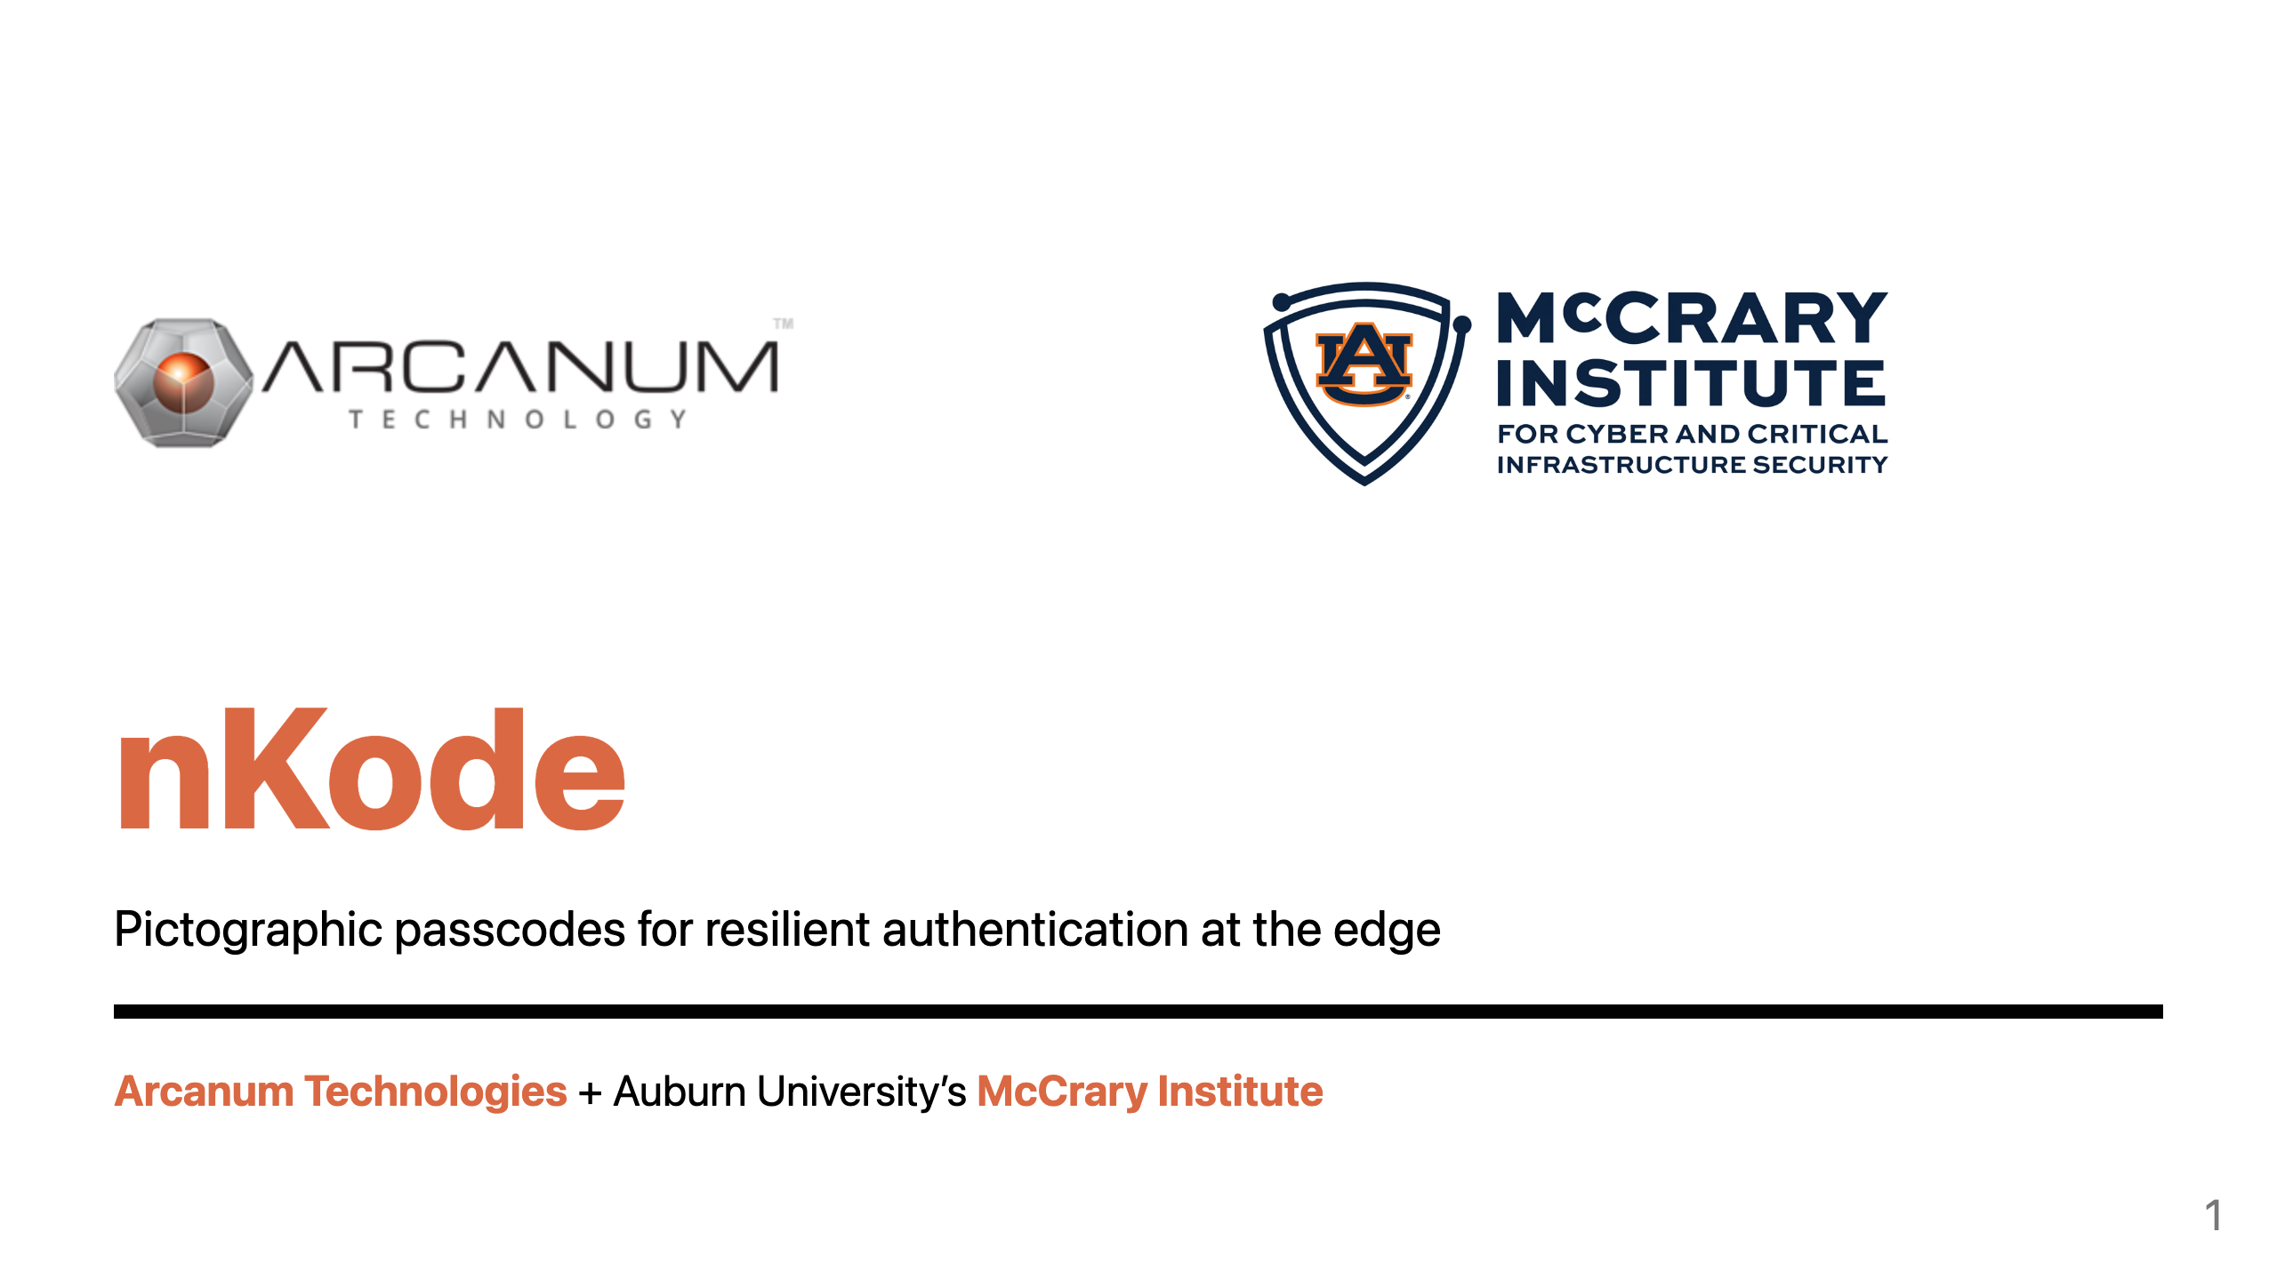
Notes:
Hello, My name is Donovan Kelly, CTO at Arcanum Technologies. We've developed nKode, a patented pictographic passcode that reinvents authentication, making it more secure and intuitive for tactical edge environments. Arcanum has partnered with the McCrary Institute at Auburn University to leverage their cybersecurity expertise and veteran insights.

Slide 2
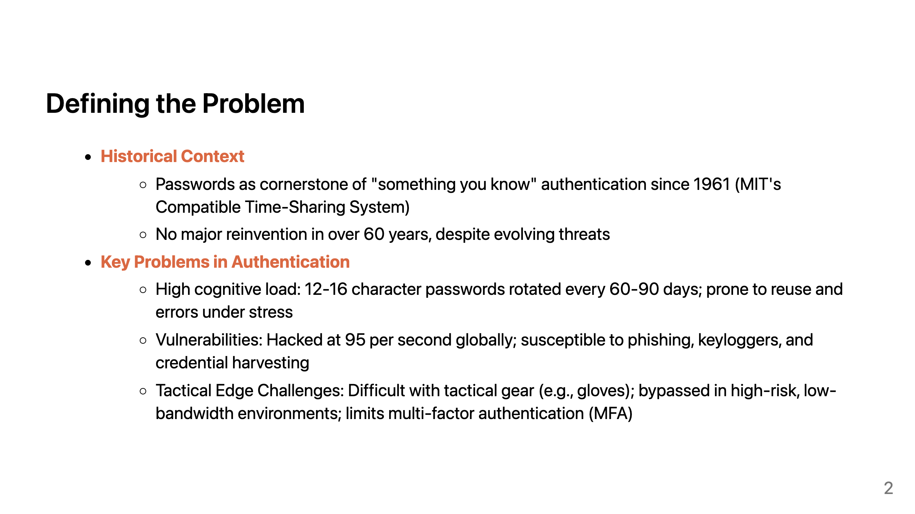
Notes:
Since their introduction in 1961 with MIT's Compatible Time-Sharing System, passwords have remained the cornerstone of "something you know" authentication. Yet, amid the rapid escalation of cyber threats over the ensuing six decades, this paradigm has undergone little fundamental reinvention. Passwords impose a taxing cognitive burden on warfighters, necessitating the memorization and periodic rotation of 12-16 character sequences every 60-90 days, a process prone to reuse across systems and errors amid high-stress operations. Their vulnerabilities are profound, with breaches occurring at a staggering rate of 95 per second worldwide, rendering them highly susceptible to credential harvesting. At the tactical edge, these deficiencies are amplified by environmental constraints. Inputting credentials while encumbered by tactical gear, such as gloves, proves impractical and often leads to security bypasses in high-risk, low-bandwidth scenarios that also constrain multi-factor authentication. Compounding this, AI-orchestrated attacks from nation-state actors intensify the overall threat landscape, underscoring the urgent need for evolution.

Slide 3
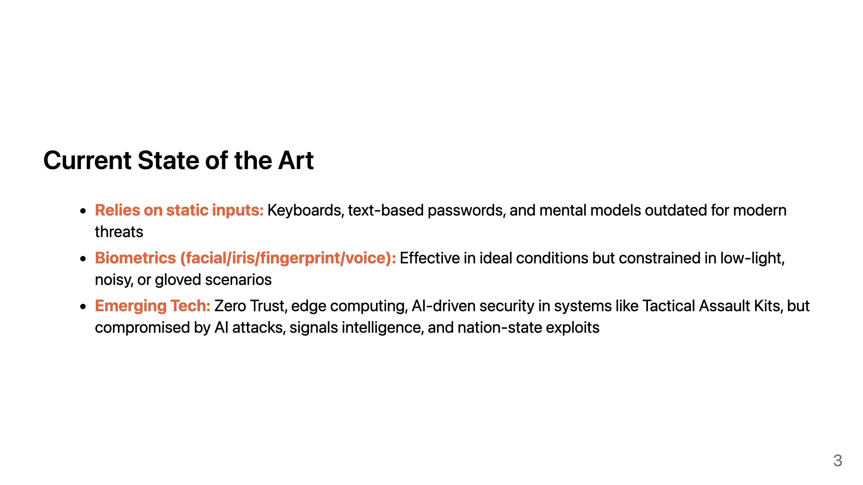
Notes:
The state of the art includes static text inputs and biometrics like facial recognition or fingerprints, which work well in controlled environments but falter in real-world tactical scenarios, think low light for iris scans, noise for voice, or gloves blocking fingerprints. Systems like Software-Defined Radios and Tactical Assault Kits integrate Zero Trust and edge computing for better security, but they still rely on vulnerable authentication methods that AI exploits, cognitive electronic warfare, and signals intelligence can crack. This is where nKode steps in, addressing these gaps by advancing beyond static, text-based systems to a visual, resilient alternative.

Slide 4
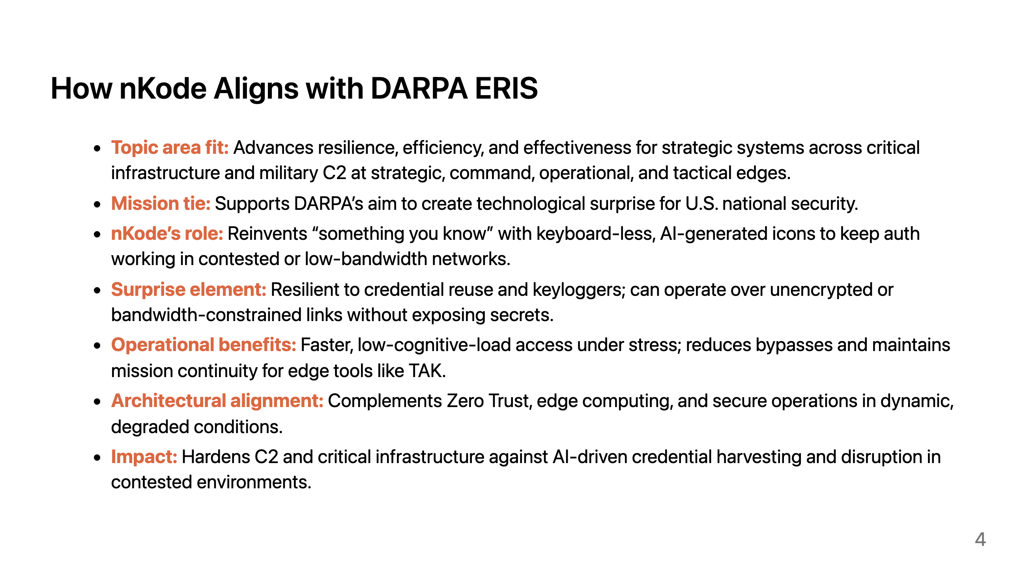
Notes:
nKode aligns with ERIS Topic Area “advanced technologies for improved resilience, efficiency, and effectiveness of strategic systems,” including critical infrastructure and military C2 across all edges. In real-world degraded comms where passwords, OTPs, or push prompts fail or are vulnerable, nKode strengthens authentication with keyboard-less icon challenges that move over low-bandwidth or even unencrypted pipes while staying resistant to capture and replay. This yields quick, low-cognitive-load logins under stress. The approach supports DARPA’s goal of technological surprise by denying adversaries easy wins from phishing and keylogging and by staying operable when bandwidth and trust are scarce.

Slide 5
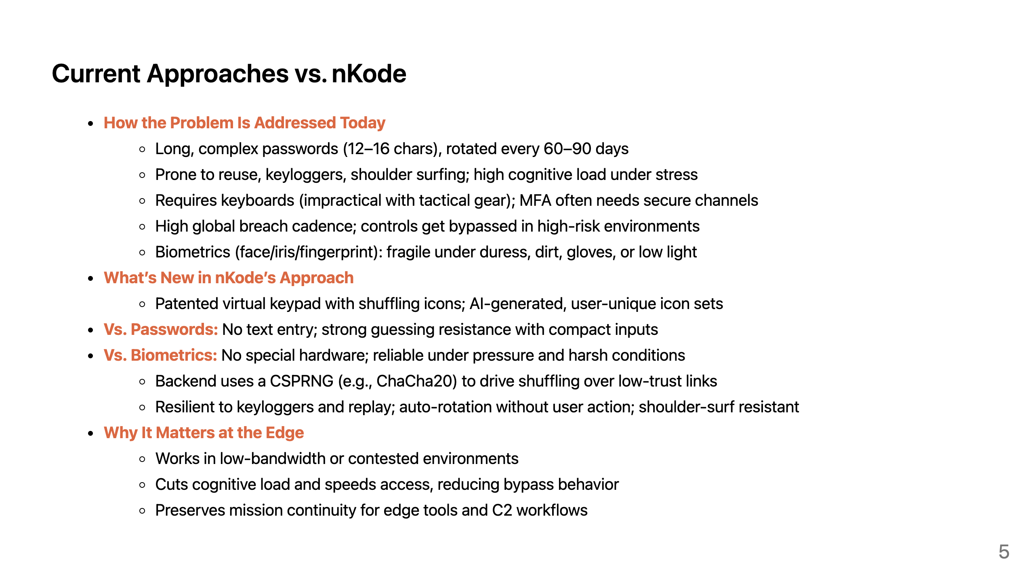
Notes:
nKode's dynamic, visual paradigm changes something you know authentication. Icons are mapped to encrypted backend tokens that make offline attacks almost impossible. What's more, these backend tokens are constantly changing. The user's nKode hash can change every month, week or even after every login without the user's needing to change their icons. Unlike static passwords or biometrics, nKode prevents reuse. Each user's keypad is composed of unique AI-generated icons and can operates in low-bandwidth environments by storing those icons on the warfighters device. This flips the usability-security trade-off because it's easier to remember and more secure than a password.

Slide 6
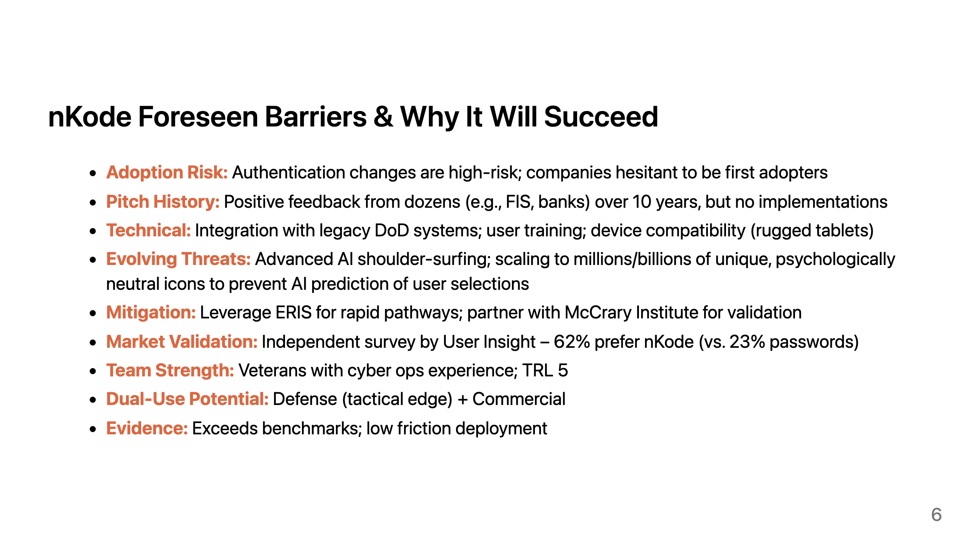
Notes:
Our largest barriers is institutional inertia despite excitement from Fortune 500 fintech companies like FIS.
Authentication is a very risky technology to change and nobody wants to be the first to do it.
Other challenges are more technical.
We're able to create 10s of thousands of icons with human in the loop validating the quality of icons.
If we scale to millions or billions of icons quality will be a challenge but it's something we can over come.
The larger challenge will be to ensure that icons are psychologically neutral, and free of bias that could make selections predictable.
Despite these challenges, nKode has a great chance of succeeding. We've had a market acceptance study conducted by User Insight.
nKode was favored by 62% of participants. A 35% favorability score is considered a high score for a new product.
We scored above norms, indicating strong usability. nKode's security and easy of use will drive it's adoption.

Slide 7
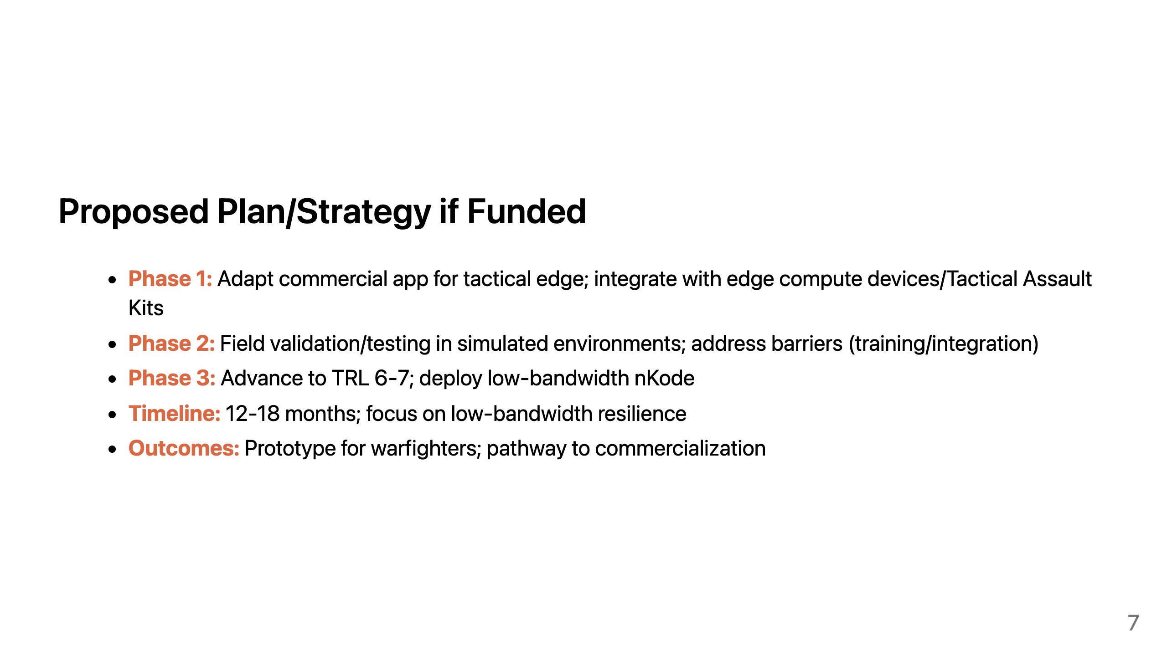
Notes:
We've developed a number of nKode based applications for warehouse's, banks, and for B2C web apps using with OpenID connect.
If funded, we'll pivot our existing commercial applications to defense needs.
We've already developed a glove-friendly version for tactical edges.
We'll continue our work to get an application into warfighter hands for feedback and we'll work with warfighter to address their needs.

Slide 8
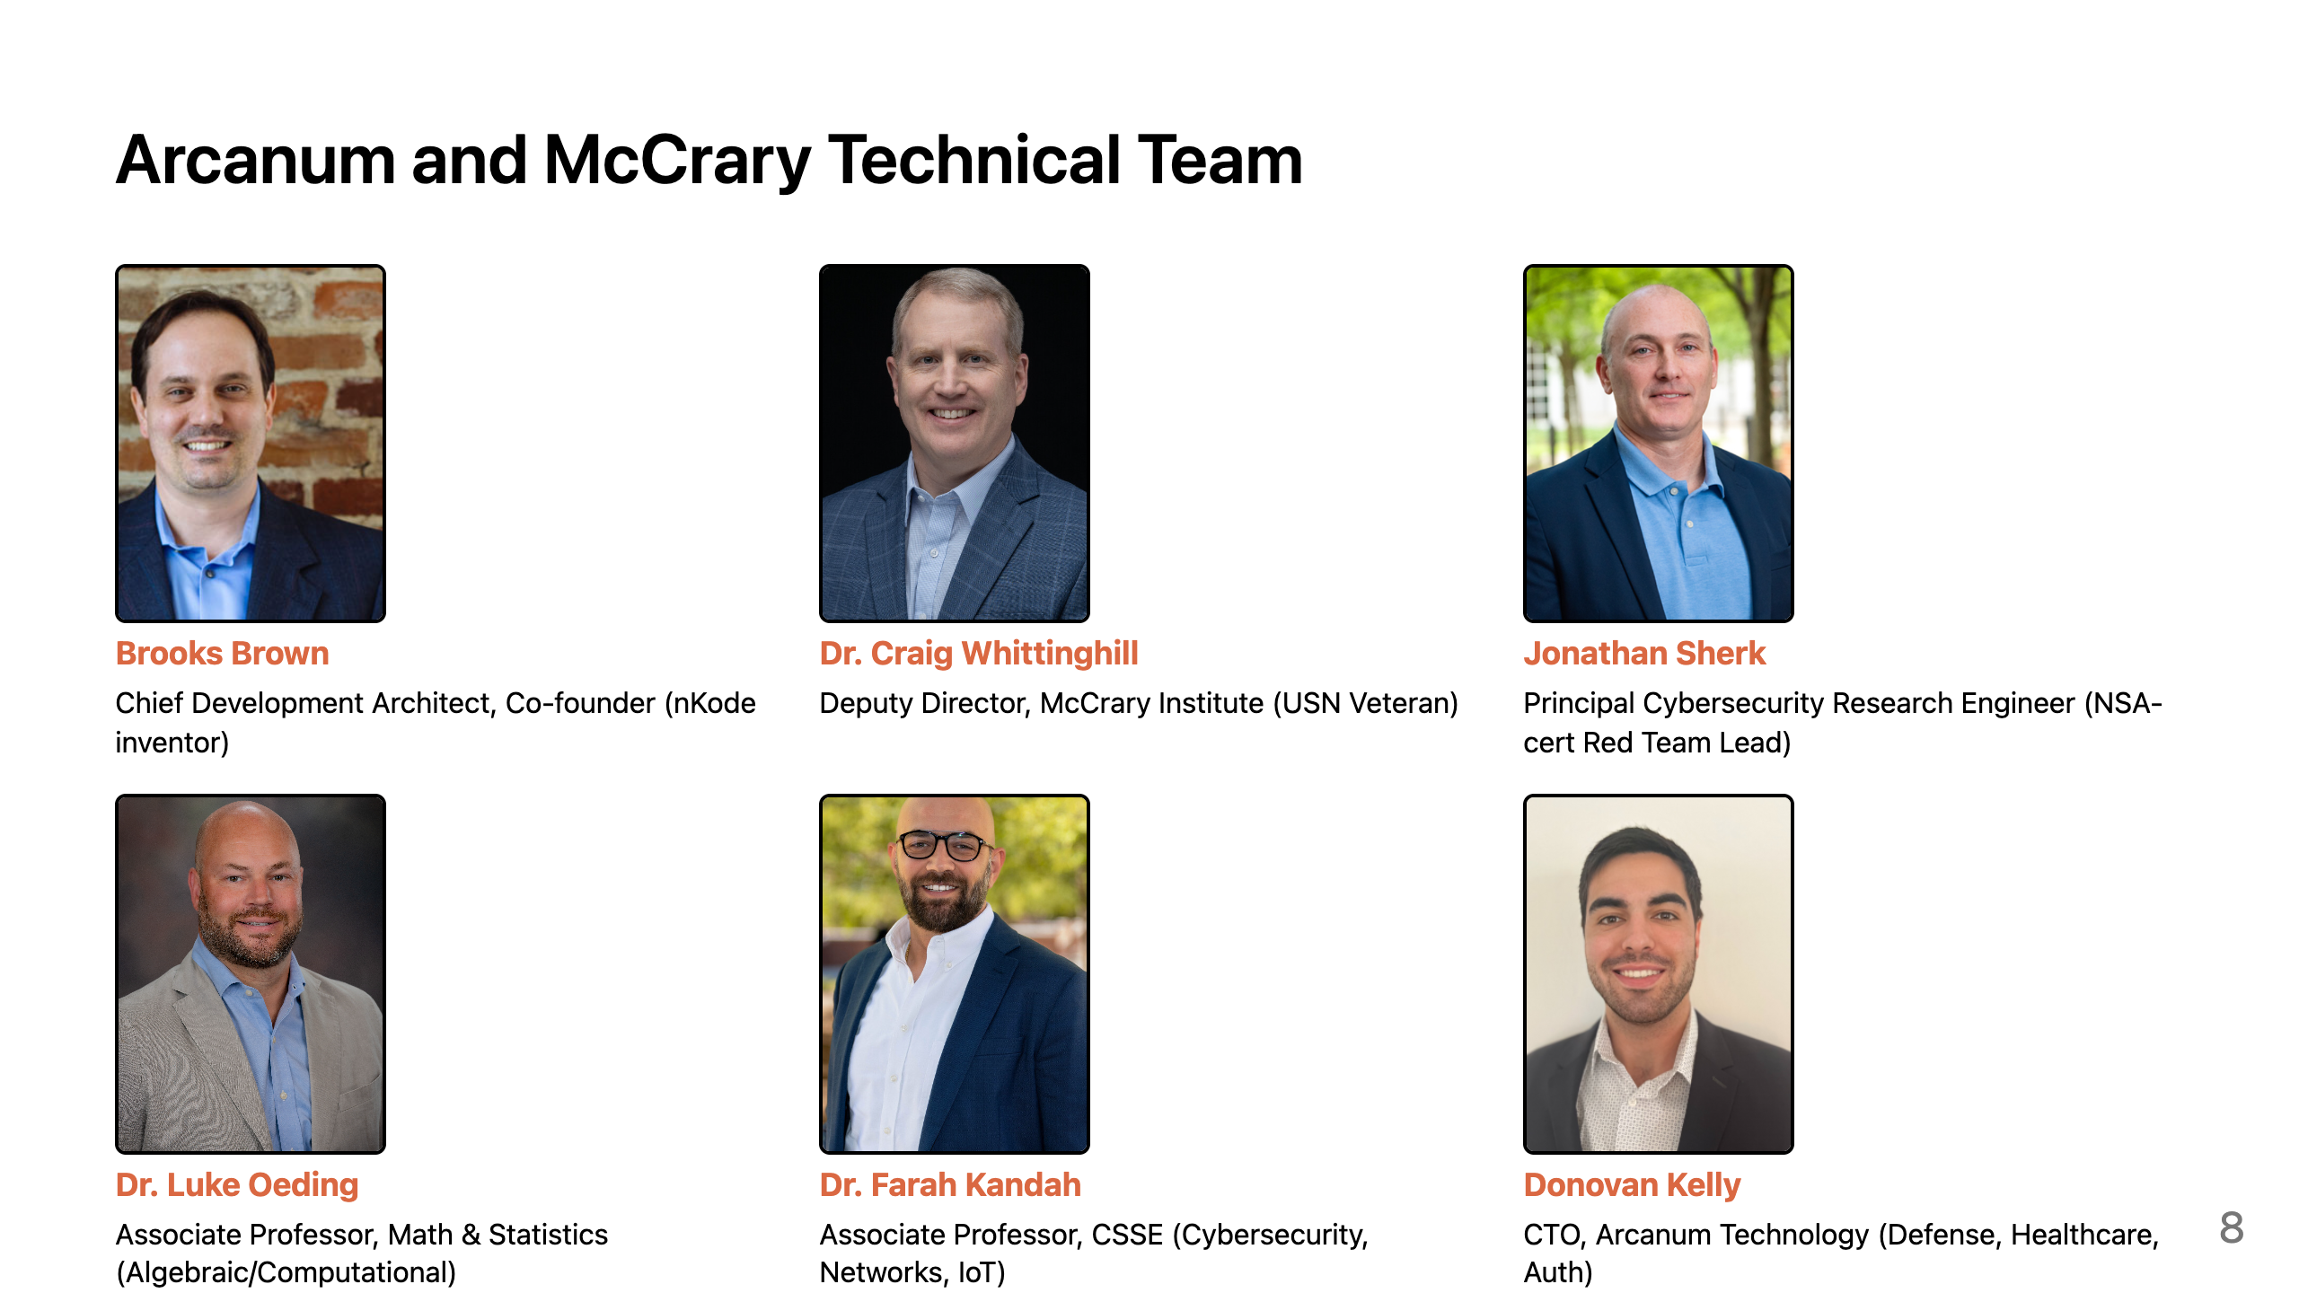
Notes:
The nKode team represents a collaborative effort between Arcanum Technology LLC and Auburn University’s McCrary Institute for Cyber and Critical Infrastructure Security. It comprises cybersecurity experts, university professors, and innovators focused on advanced authentication solutions.

Slide 9
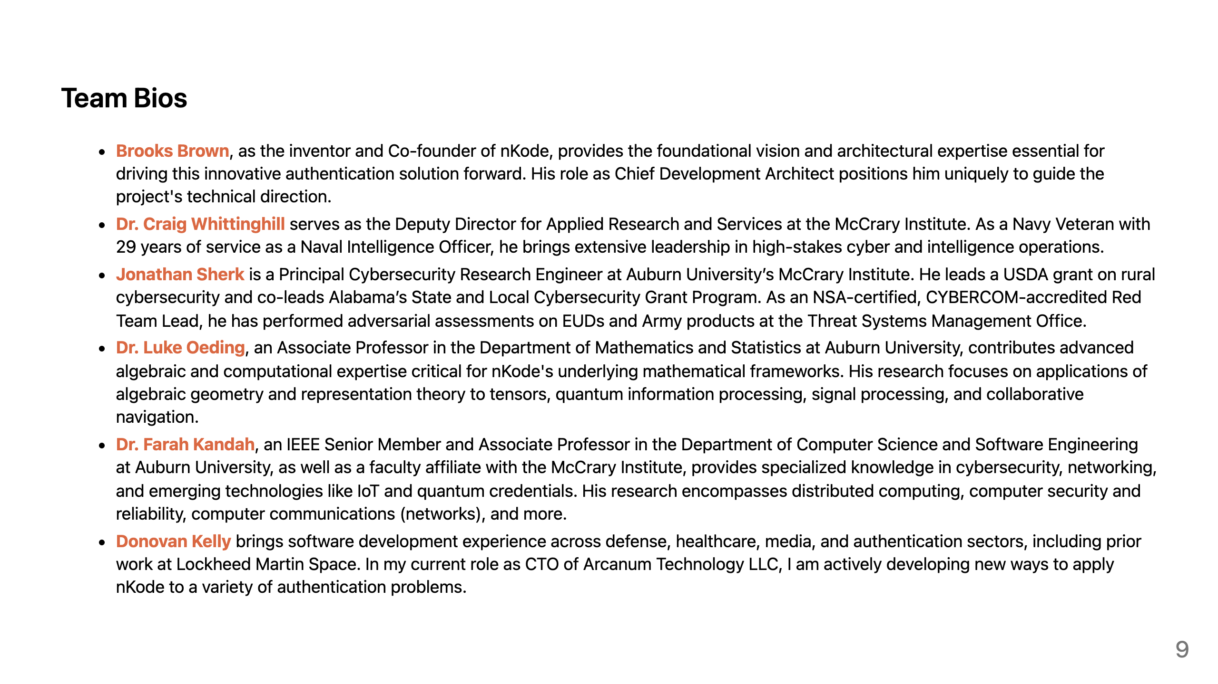
Notes:
The key members of the nKode team include Brooks Brown, who serves as the inventor, co-founder, and chief development architect; Dr. Craig Whittinghill, the deputy director and a Navy veteran with deep expertise in cyber and intelligence operations; Jonathan Sherk, a principal cybersecurity research engineer leading grants and red team assessments; Dr. Luke Oeding, an associate professor of mathematics specializing in algebraic geometry and quantum applications; Dr. Farah Kandah, an associate professor of computer science with a focus on cybersecurity, IoT, and networking; and Lastly me. I'm the CTO at Arcanum. I bring software development experience from defense, media, and healthcare sectors.

Slide 10
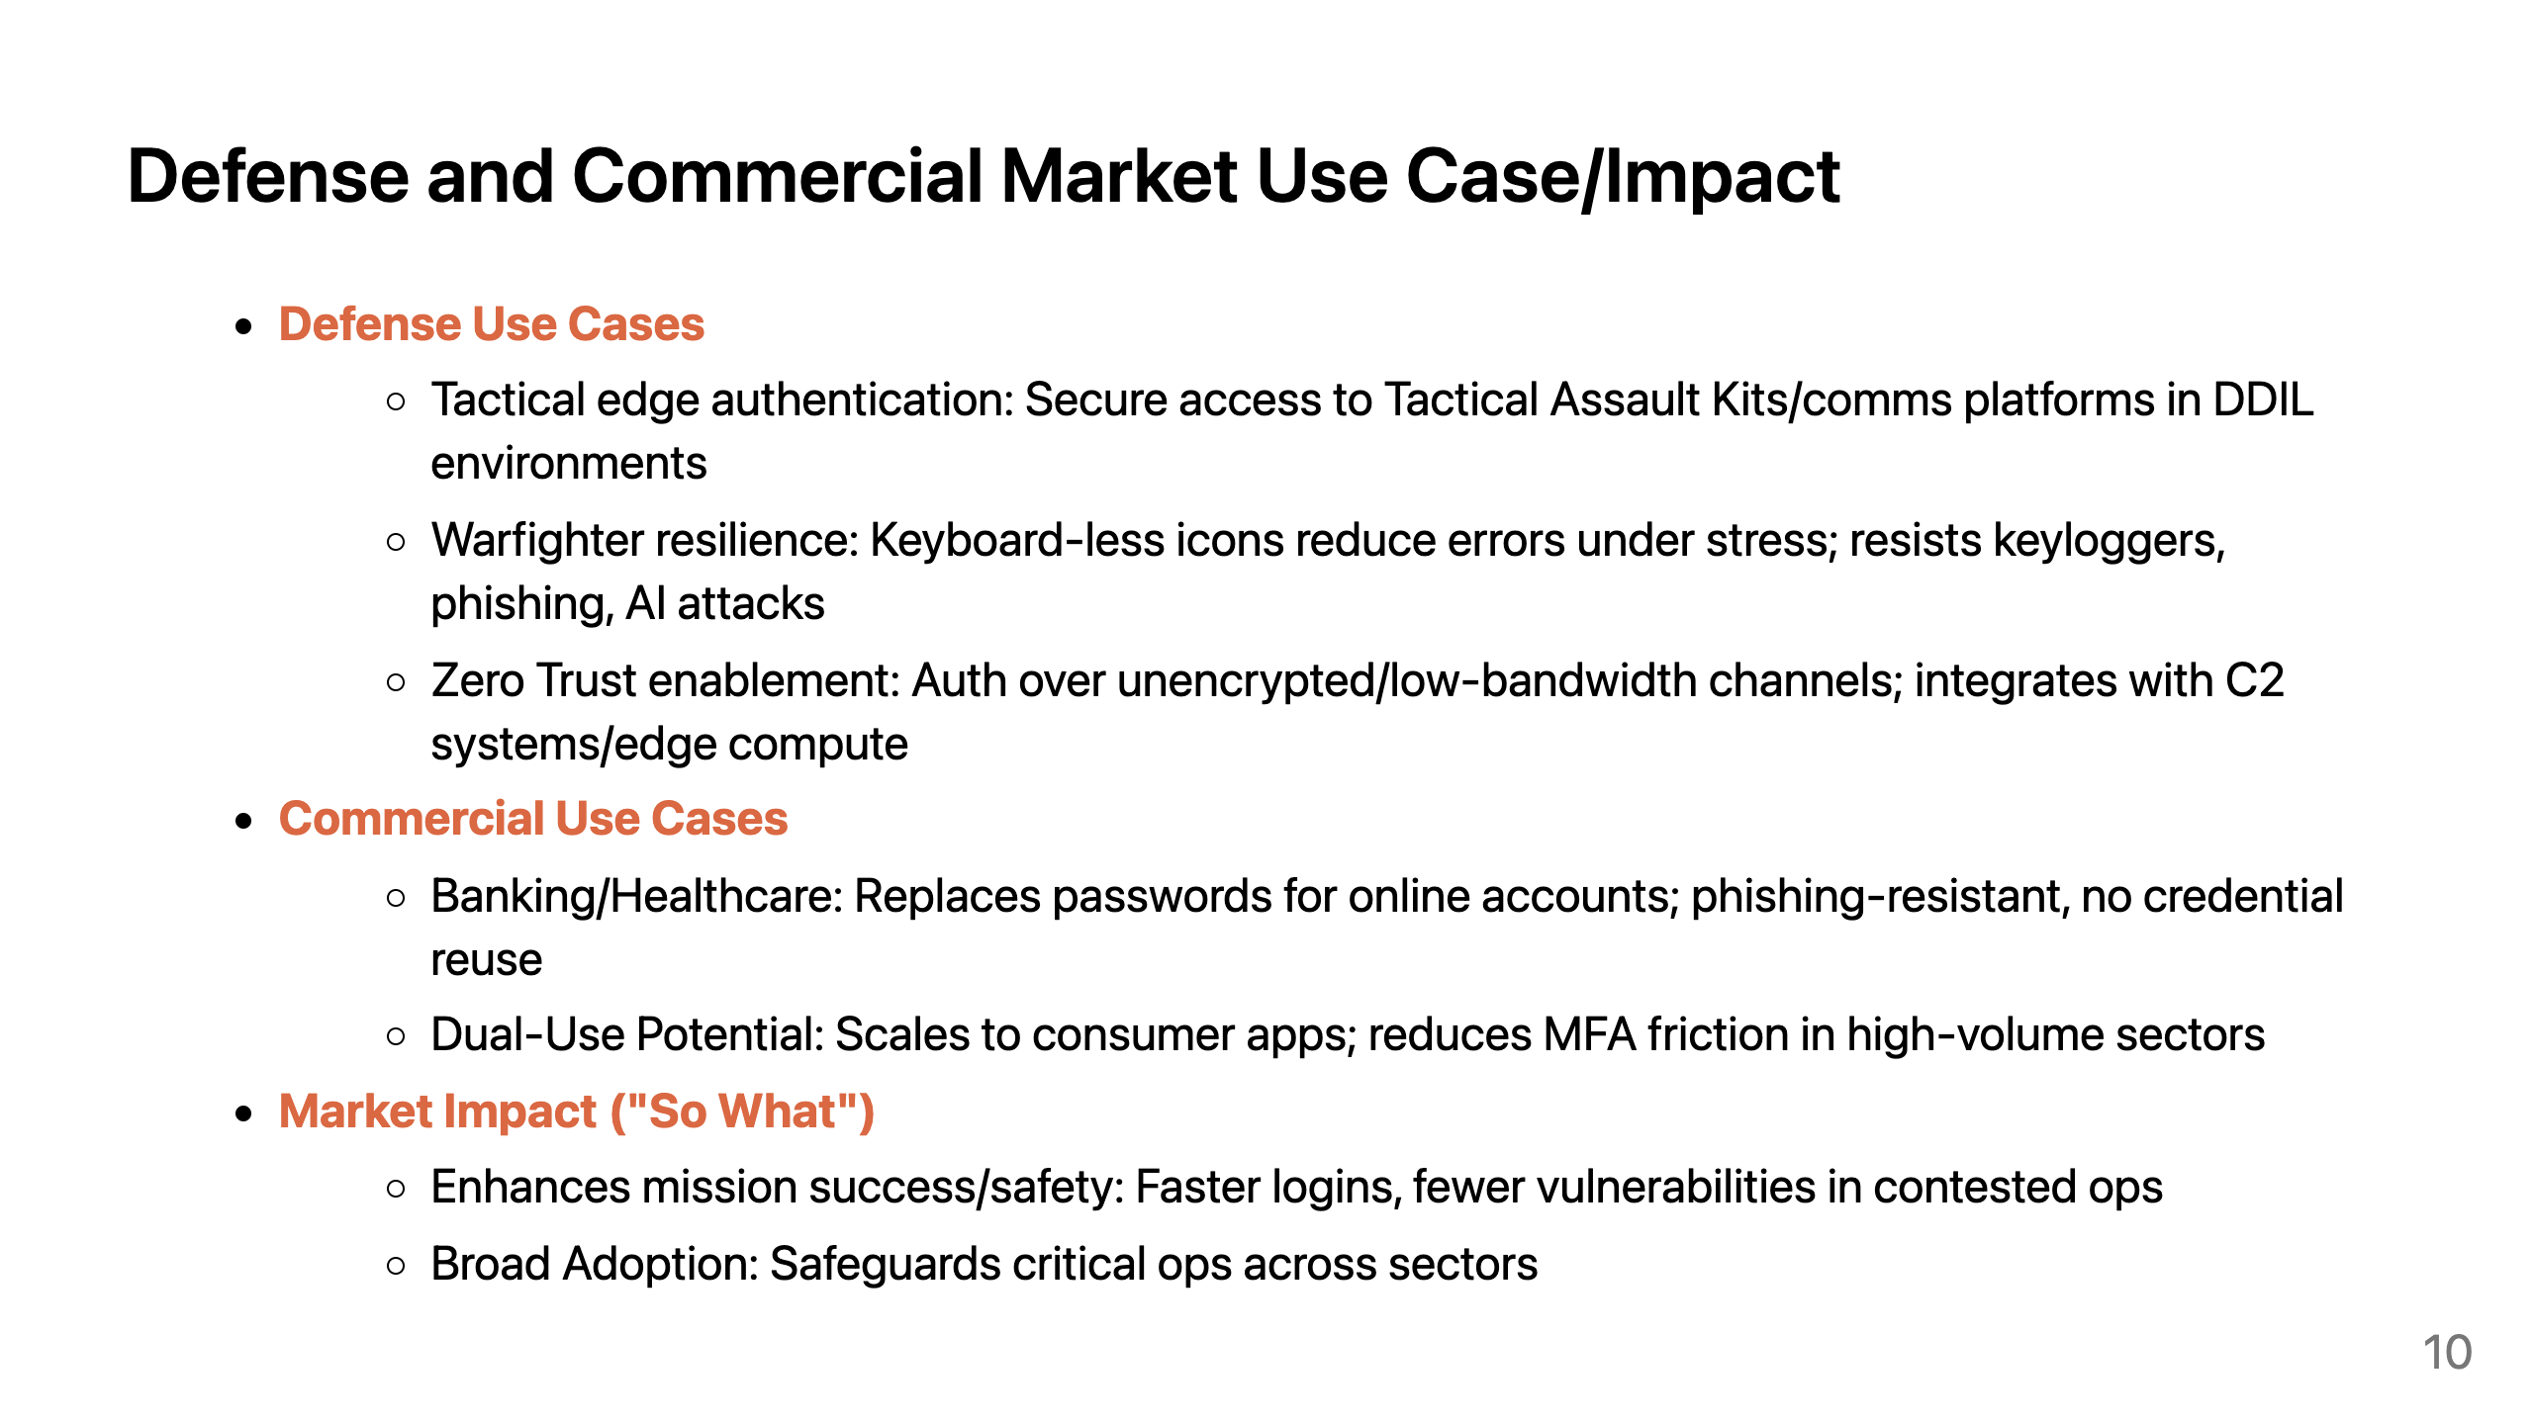
Notes:
nKode offers significant impact in both defense and commercial markets.
In defense, nKode targets tactical edge challenges where current authentication systems falter.
Warfighters authenticate to secure comms or field kits via intuitive icons, reducing bypass risks.
The impact is stronger defenses, mission success, and warfighter safety.
Commercially, nKode addresses massive markets. : Replaces vulnerable passwords in banking (reducing phishing losses) or healthcare (securing patient data).
nKode closes usability-security gaps, created by passwords.

Slide 11
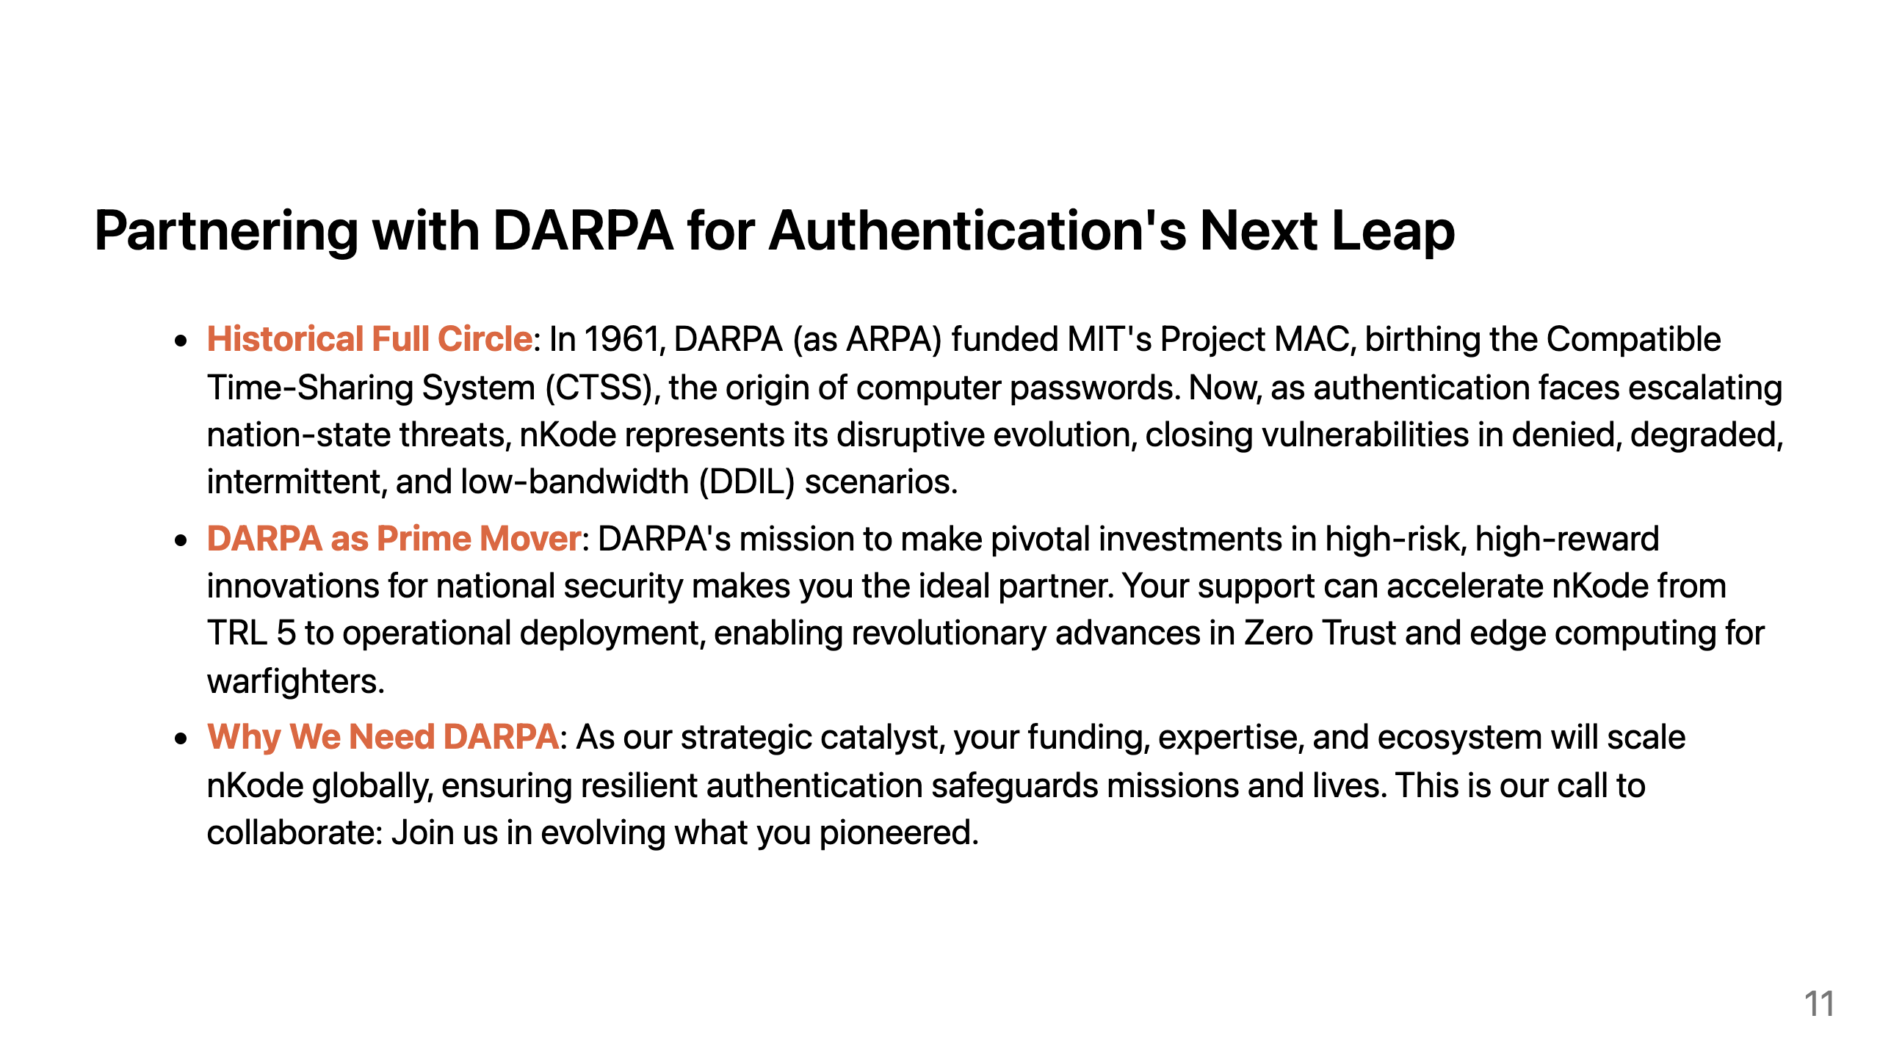
Notes:
Back in 1961, DARPA, then ARPA, funded MIT's Project MAC, which led to the Compatible Time-Sharing System, and the very first use of computer passwords.
DARPA, the prime mover in transformative tech. Your mission is to make pivotal investments in high-risk, high-reward innovations for national security.
That's why we need DARPA now, as our strategic catalyst. Your funding, expertise, and vast ecosystem will help us scale nKode, ensuring resilient authentication that safeguards missions, infrastructure, bank accounts, healthcare and more. Together, we can close this 60-year loop. Let's partner to evolve the authentication paradigm DARPA helped pioneer, delivering high-reward innovations that secure our nation's future against evolving threats.

