Slide 1
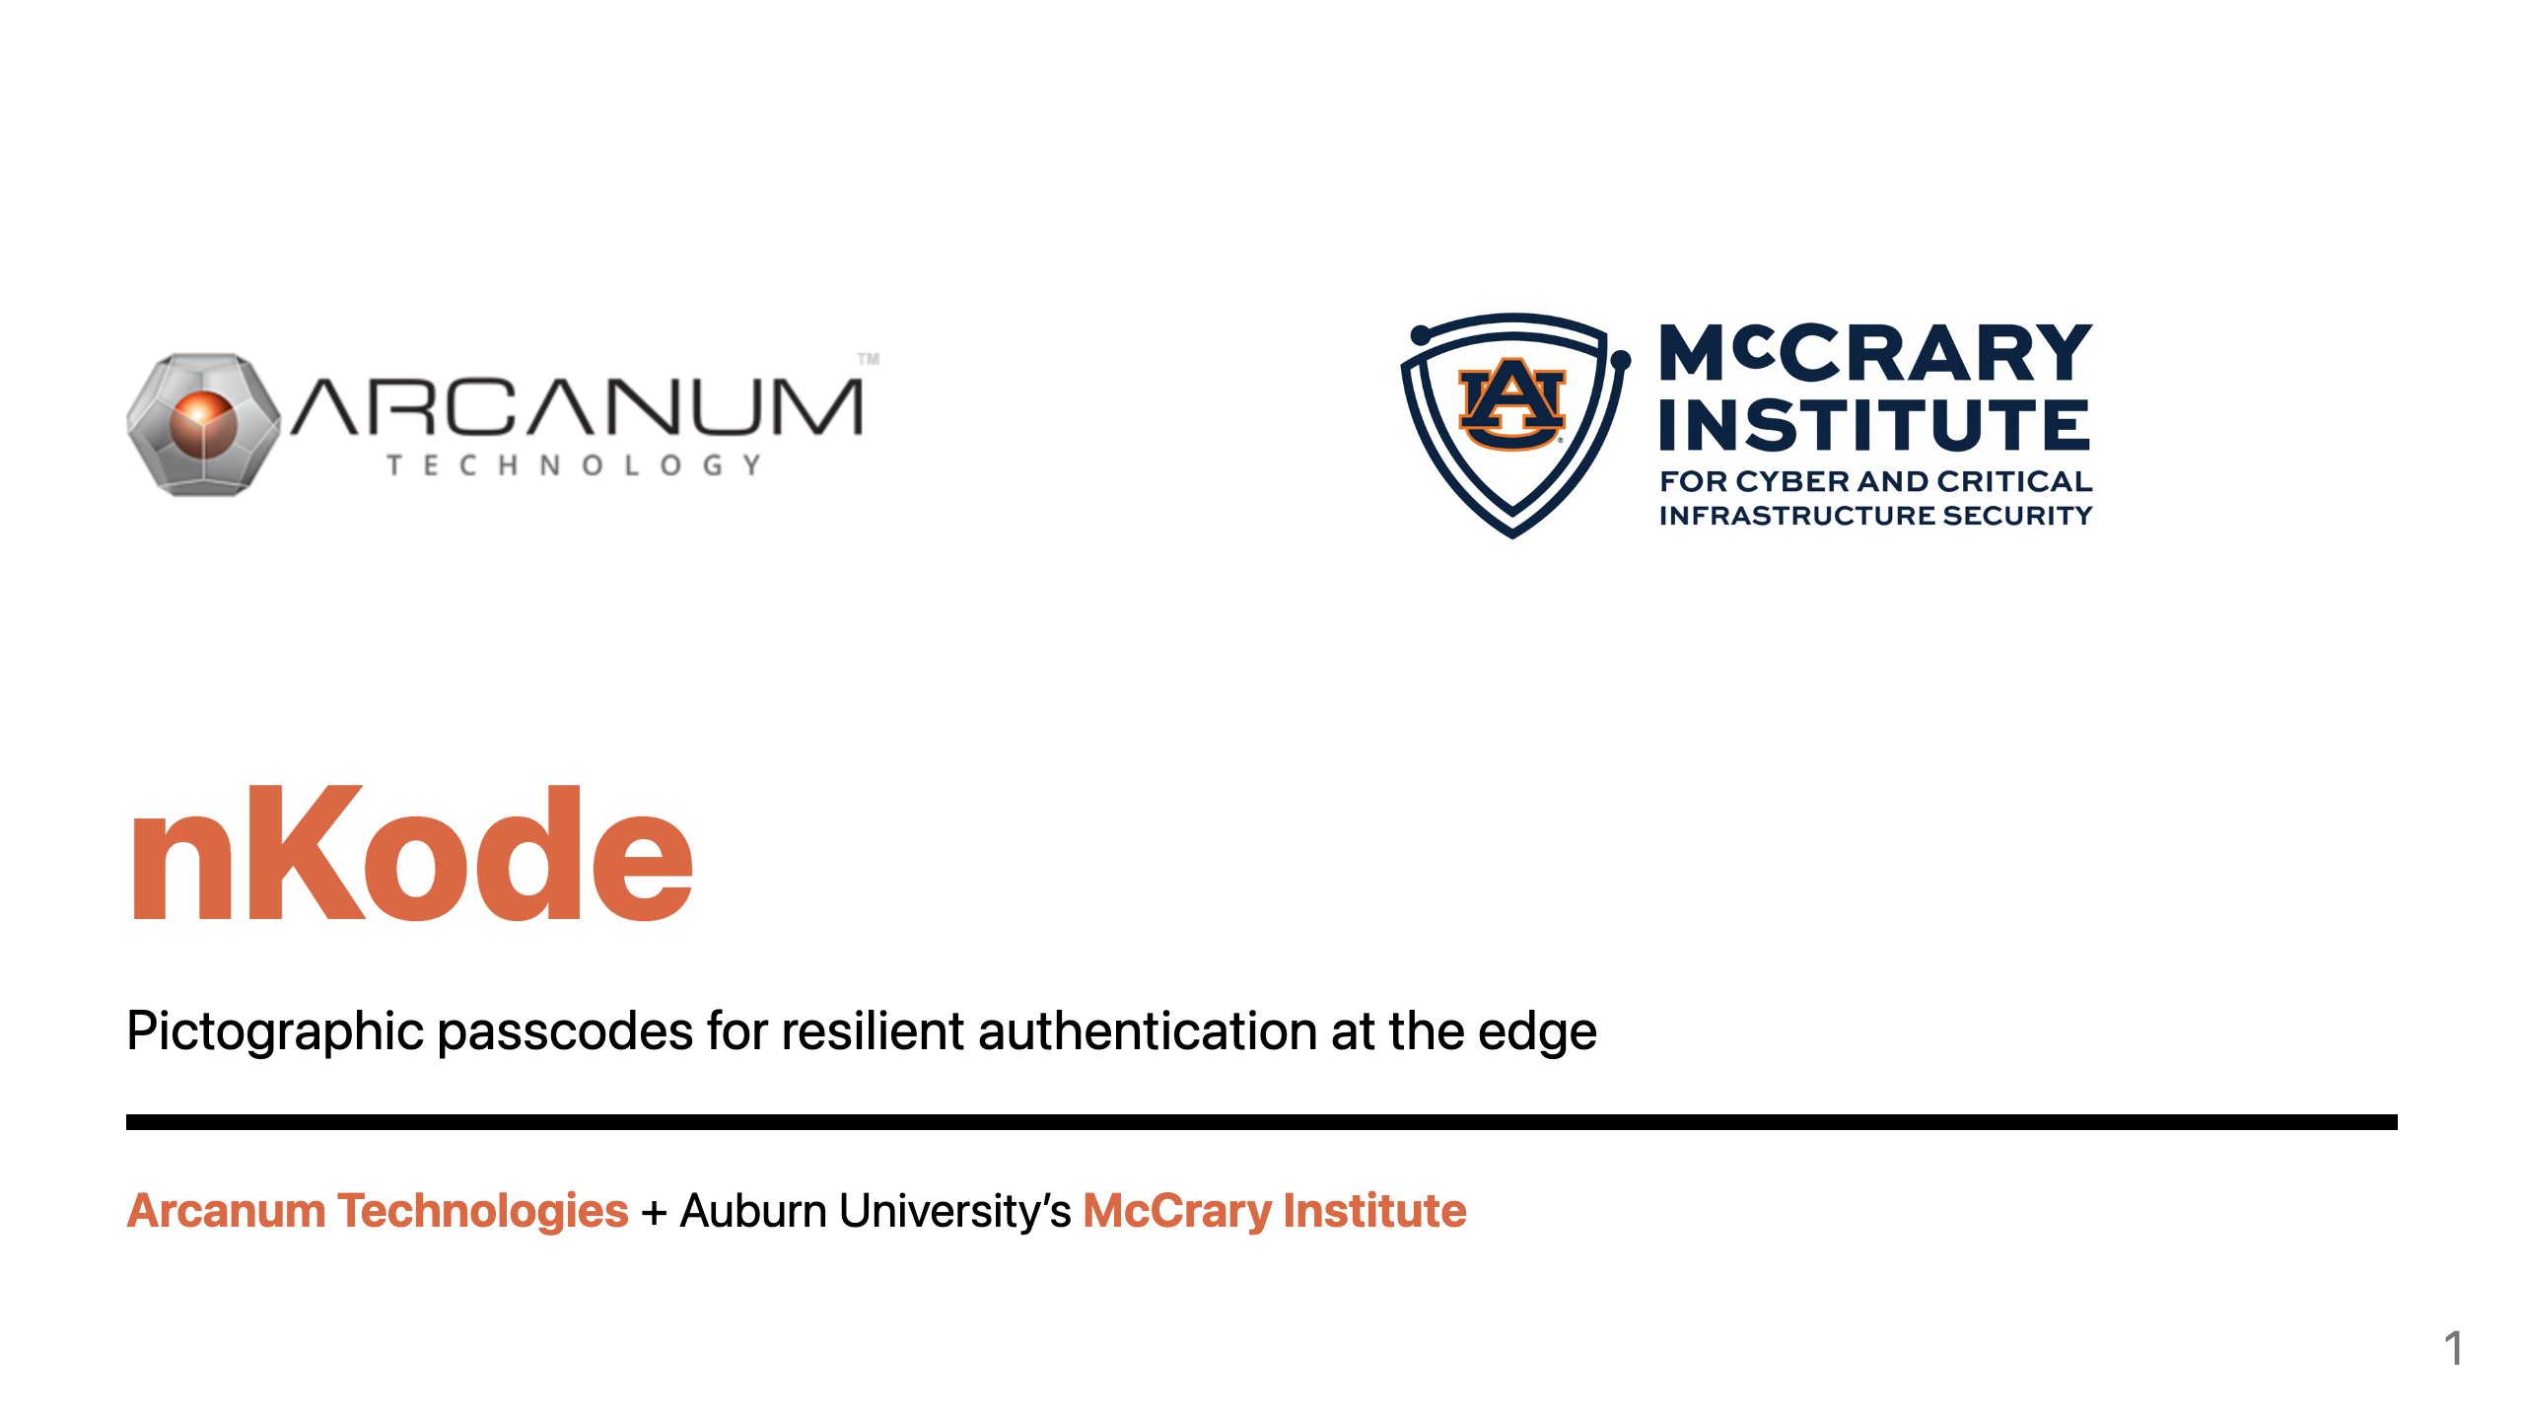
Notes:
Speaker Notes: Title
Hello, My name is Donovan Kelly, CTO at Arcanum Technologies. We've developed nKode, a patented pictographic passcode that reinvents authentication, making it more secure and intuitive for tactical edge environments. Arcanum has collaborated with Auburn University McCrary Institute to leverage their cybersecurity expertise and veteran insights.

Slide 2
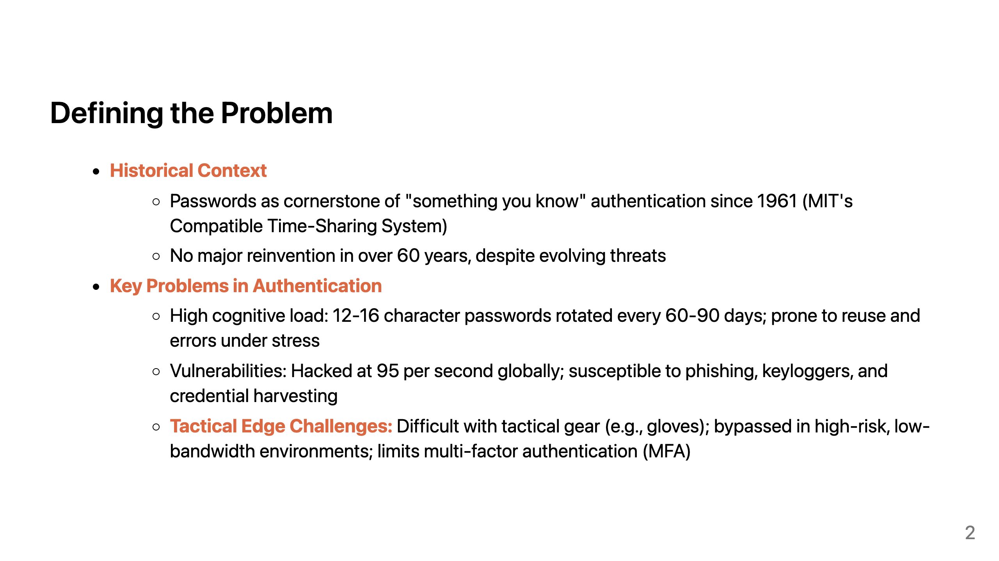
Notes:
Speakers Notes: Defining the Problem
Since their introduction in 1961 with MIT's Compatible Time-Sharing System, passwords have remained the cornerstone of "something you know" authentication. For warfighters, they impose a high cognitive and operational burden: memorizing and rotating 12–16 character strings every 60–90 days, often leading to reuse and mistakes under stress. Meanwhile, passwords are under constant attack, making them easy targets for credential harvesting. These weaknesses are amplified at the tactical edge, where gloves and gear make credential entry impractical and low-bandwidth, high-risk conditions limit conventional MFA—driving workarounds and security bypasses.

Slide 3
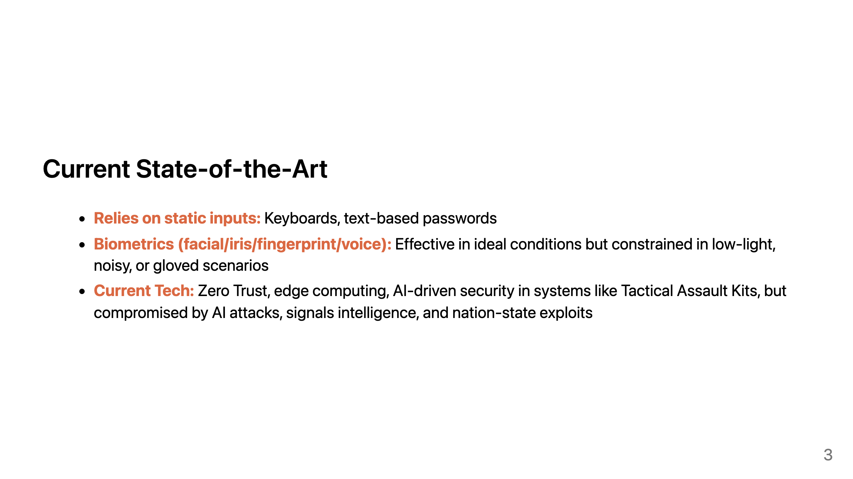
Notes:
Speakers Notes: Current State-of-the-Art
The state of the art still relies on static text inputs and biometrics like facial recognition and fingerprints. These can work in controlled settings, but in tactical edge conditions—noise, degraded visual environments, motion, low light, or gloves—biometrics’ probabilistic nature drives high failure rates. Meanwhile, Zero Trust, edge computing, and AI-driven security (e.g., Tactical Assault Kits) are advancing, yet remain vulnerable to AI-enabled attacks, signals intelligence, and nation-state exploitation.

Slide 4
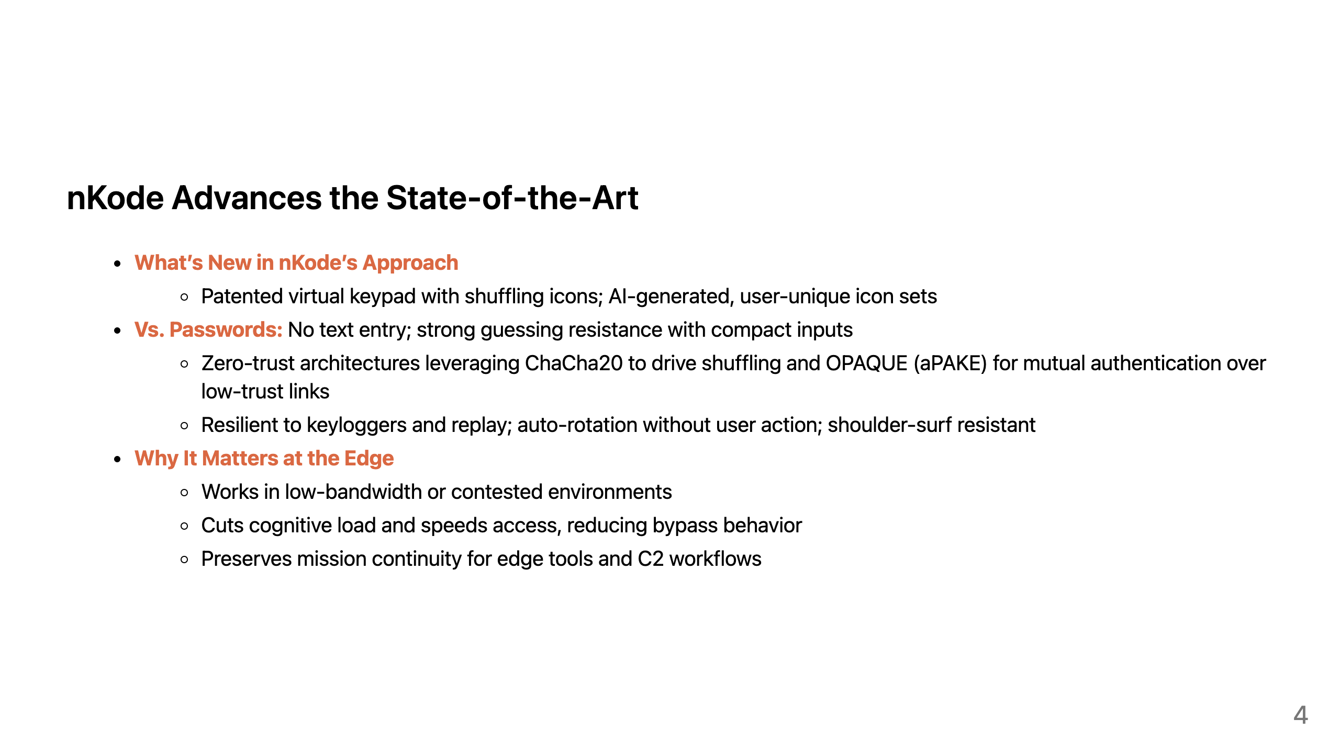
Notes:
Speakers Notes: nKode Advances the State-of-the-Art
nKode's dynamic, visual paradigm changes “something you know” authentication.
Instead of typed secrets, the user authenticates through a patented virtual keypad whose icons shuffle every session.
Each user gets a unique AI-generated icon set, and selections map to encrypted backend tokens—making offline guessing computationally infeasible and credential stuffing impossible.
Under the hood, we use a zero-trust approach: ChaCha20 drives the deterministic shuffling of the keypad, and OPAQUE, an asymmetric Passcode Authenticated Key Exchange provides mutual authentication over low-trust links.
This flips the usability-security trade-off because it's easier to remember and more secure than a password.

Slide 5
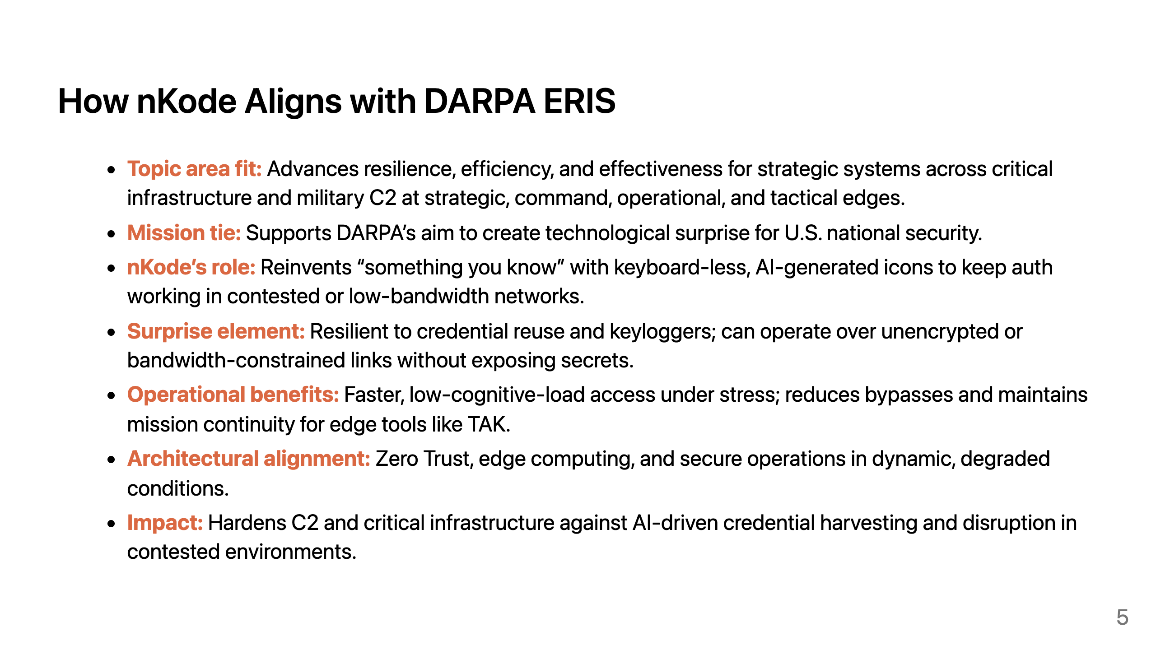
Notes:
Speakers Notes: How nKode Aligns with DARPA ERIS
nKode aligns with ERIS Topic Area “advanced technologies for improved resilience, efficiency, and effectiveness of strategic systems,” including critical infrastructure and military Command and Control. In real-world degraded comms where passwords, OTPs, or push prompts fail or are vulnerable, nKode strengthens authentication with zero-trust and keyboard-less icon challenges that move over low-bandwidth pipes while staying resistant to capture and replay. This yields quick, low-cognitive-load logins under stress. The approach supports DARPA’s goal of technological surprise by denying adversaries easy wins from phishing and keylogging.
DEMO

Slide 6
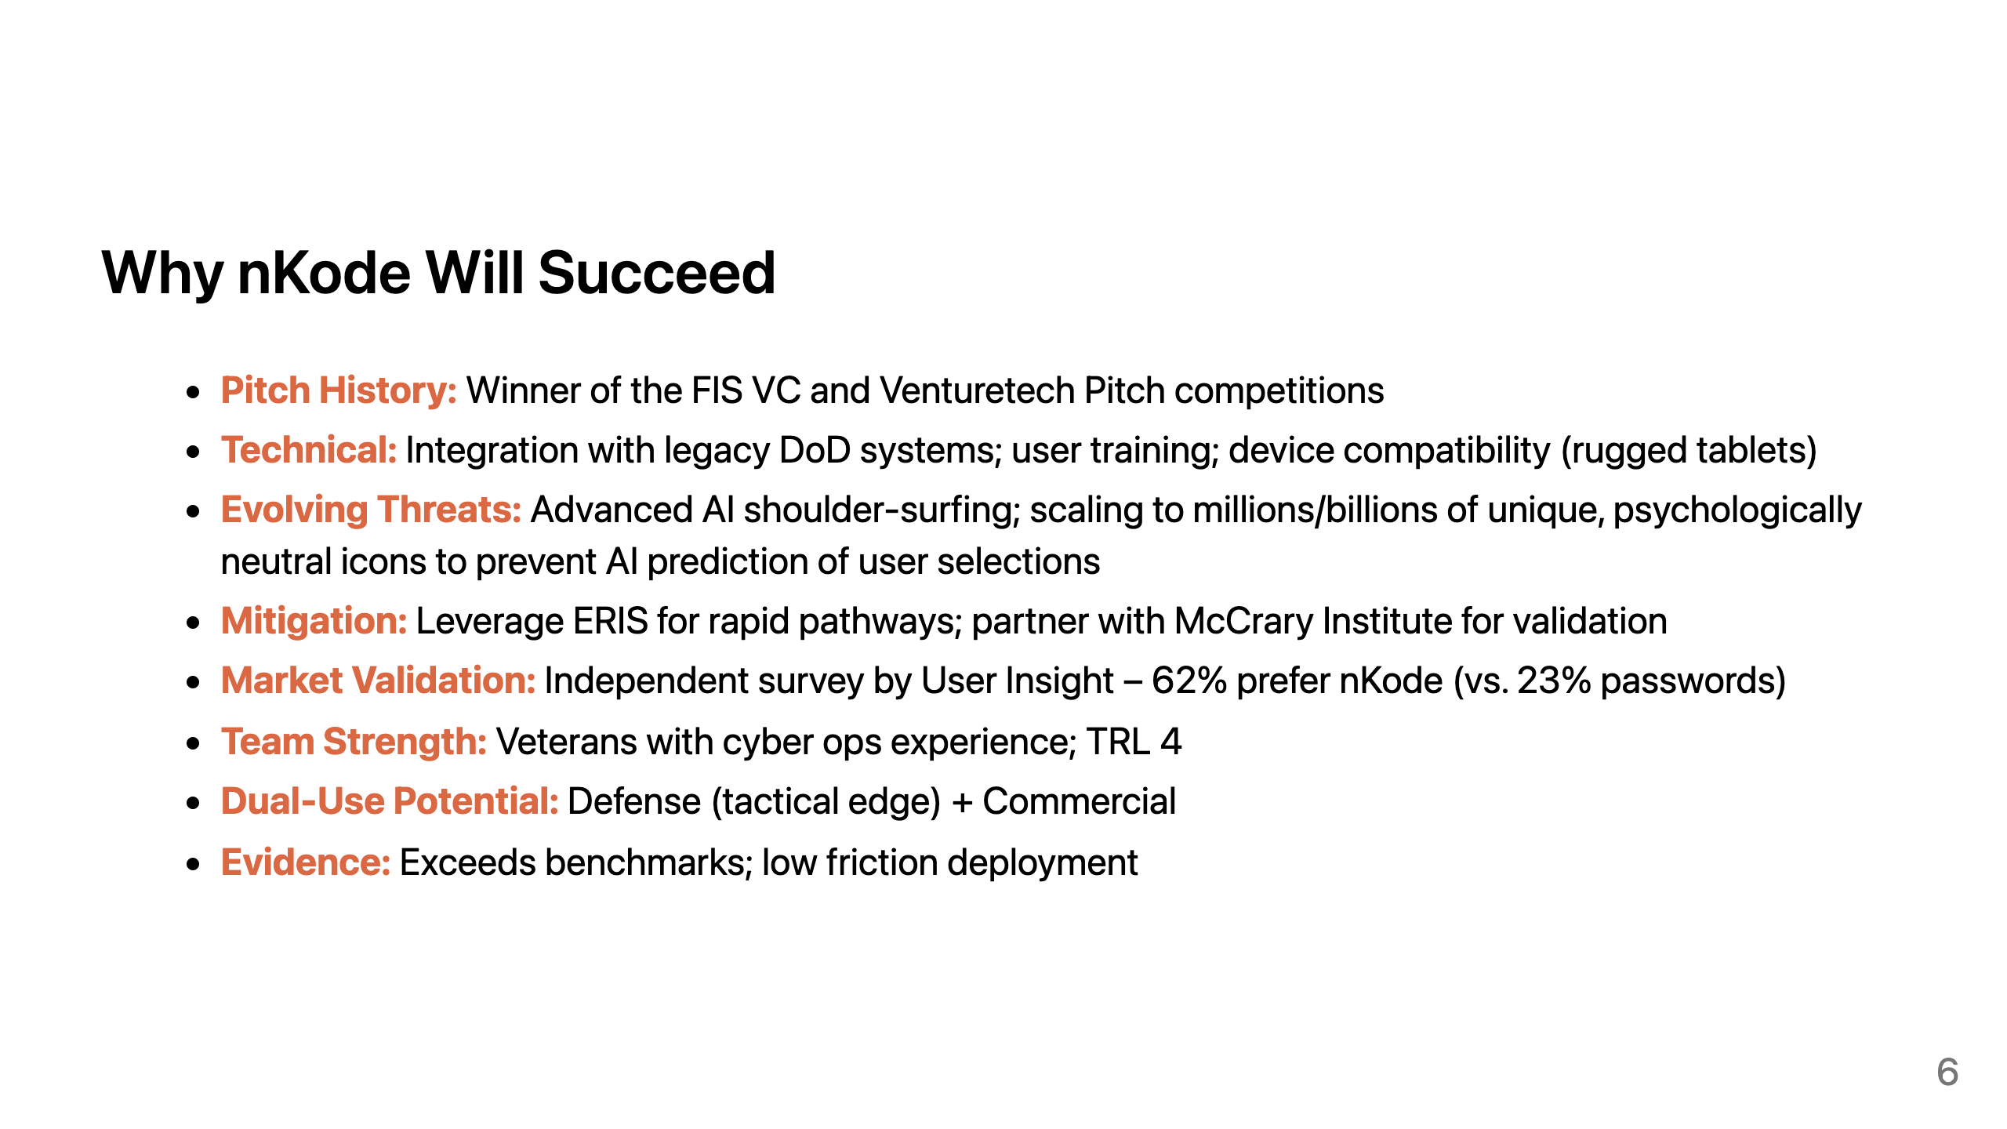
Notes:
Speakers Notes: Why nKode Will Succeed
Institutional inertia is one of our biggest challenges.
We've had interest from Fortune 500 fintech companies like FIS.
However, authentication is a risky technology to change and nobody wants to be the first to do it.
nKode has a great chance of succeeding.
We've had a market acceptance study conducted by User Insight.
A 35% favorability score is considered a high score for a new product.
nKode was favored by 62% of participants.
This is an exceptionally high favorability rating.
That underscores just how needed a password alternative is.

Slide 7
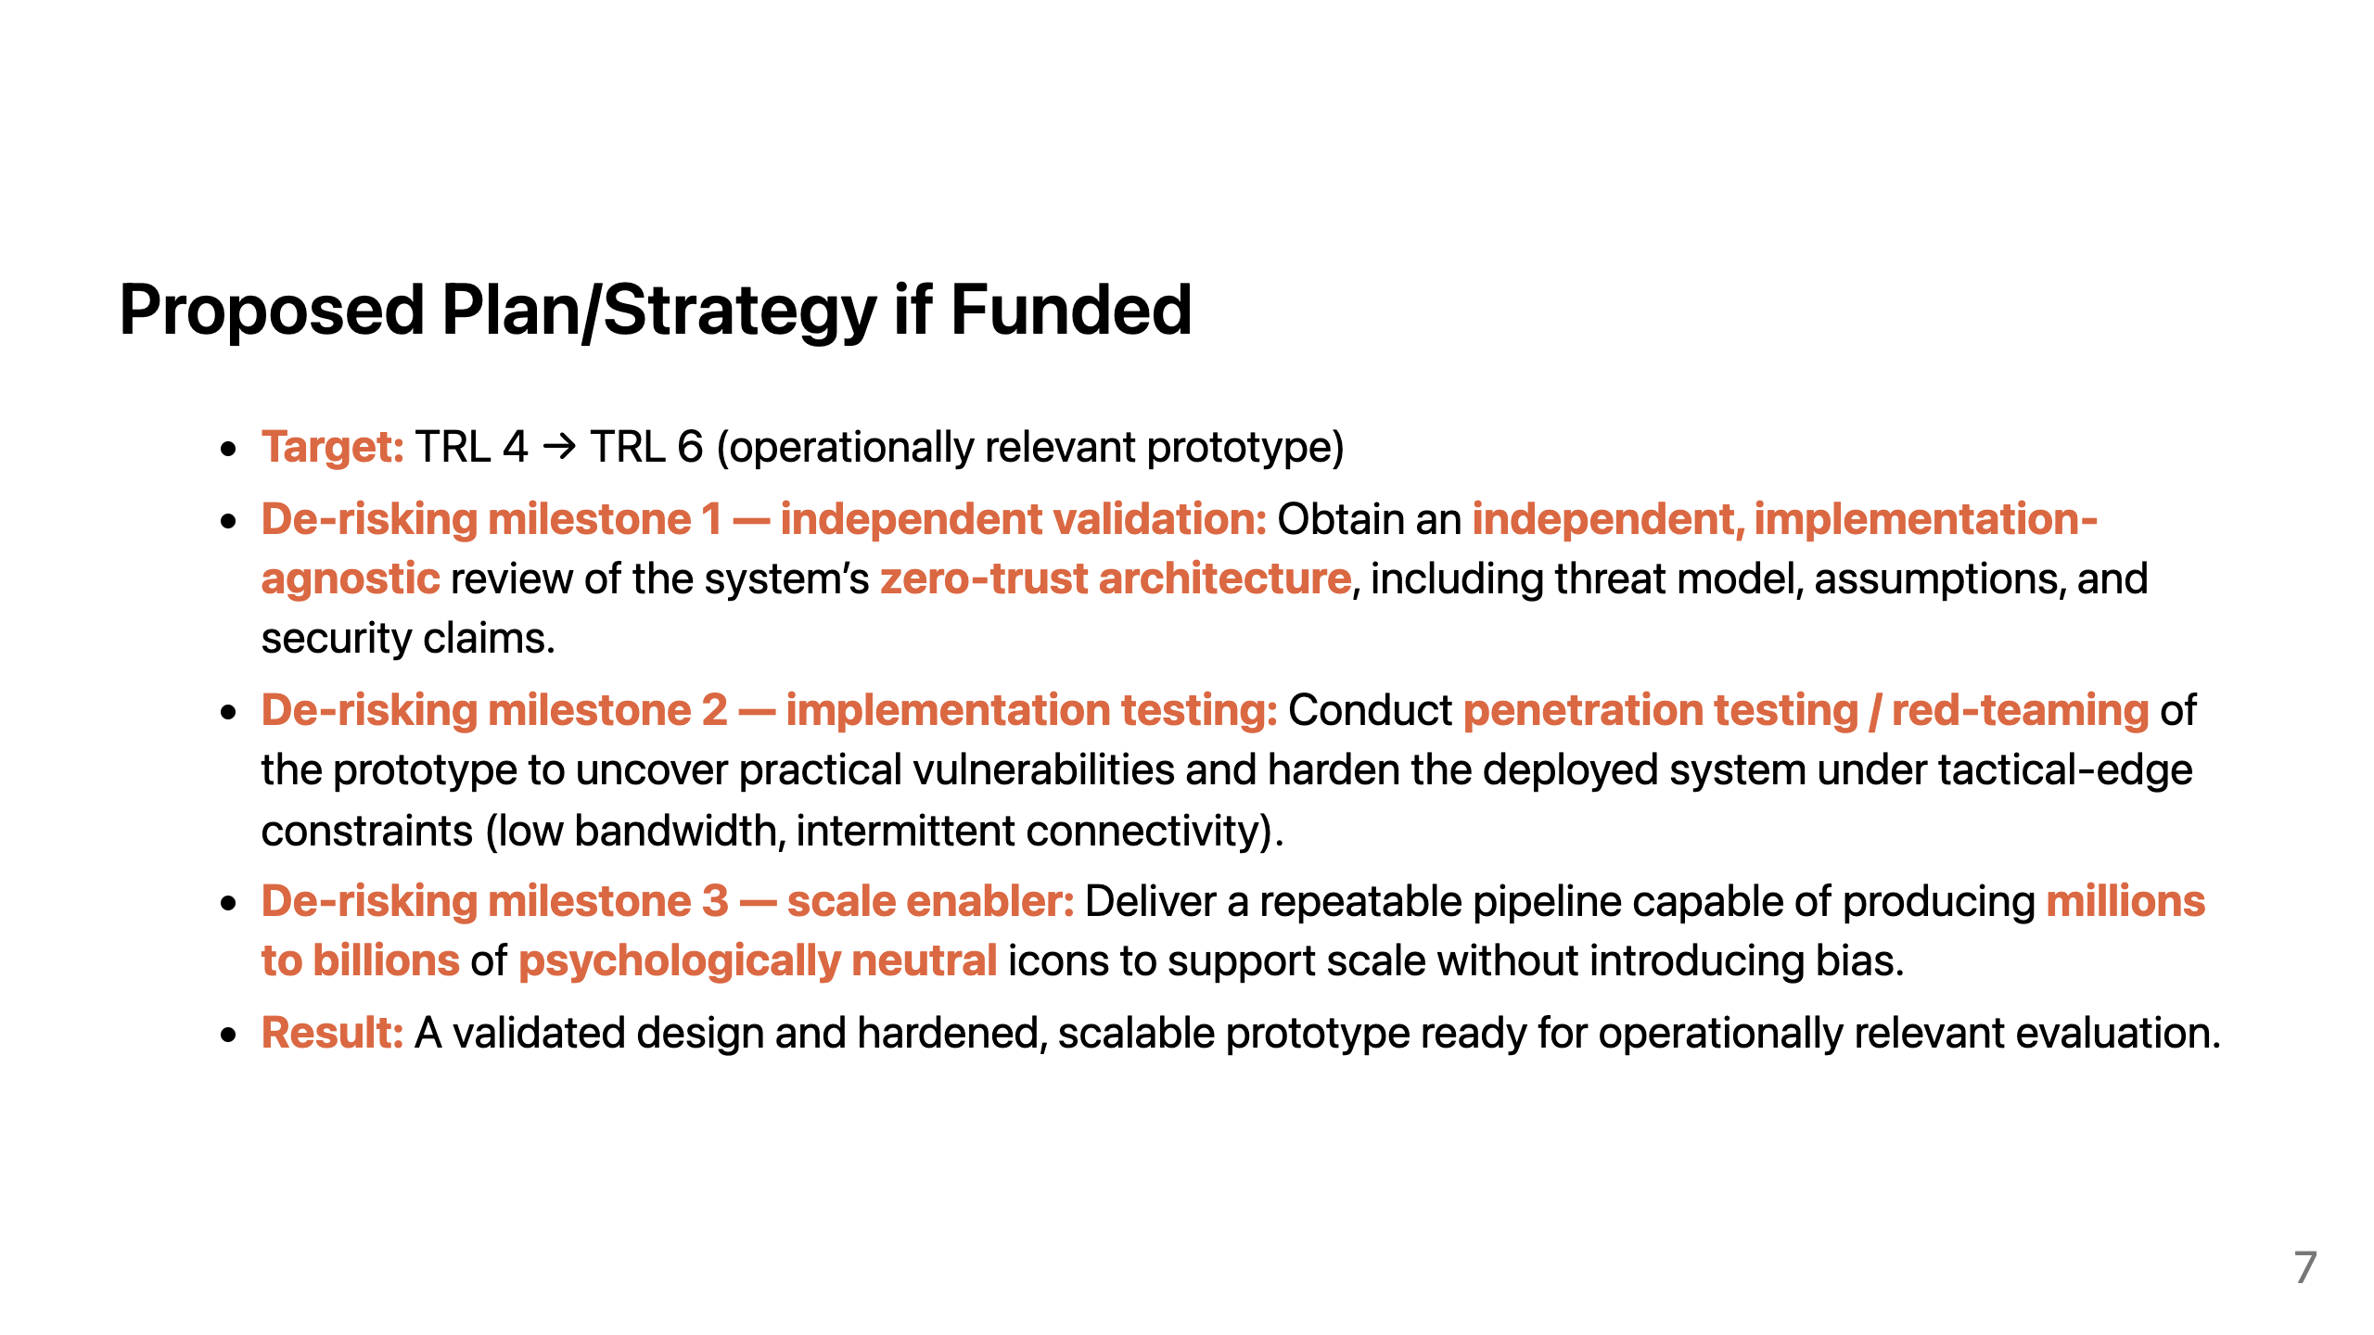
Notes:
Speakers Notes: Proposed Plan/Strategy if Funded
If we are awardable, our goal is to move from TRL 4 to TRL 6 by building an operationally relevant prototype.
First, we will commission an independent, implementation-agnostic validation of the zero-trust architecture—confirming the threat model, key assumptions, and security claims separate from any particular prototype build.
Second, we will perform implementation-focused security assessment (penetration testing / red-teaming) of the prototype in realistic tactical-edge conditions, including low bandwidth and intermittent connectivity, to identify exploitable weaknesses, harden the system, and document residual risk.
Third, we will deliver a scalable, repeatable pipeline to generate millions to billions of psychologically neutral icons so the system can scale without introducing biasing or emotionally “loaded” imagery.

Slide 8
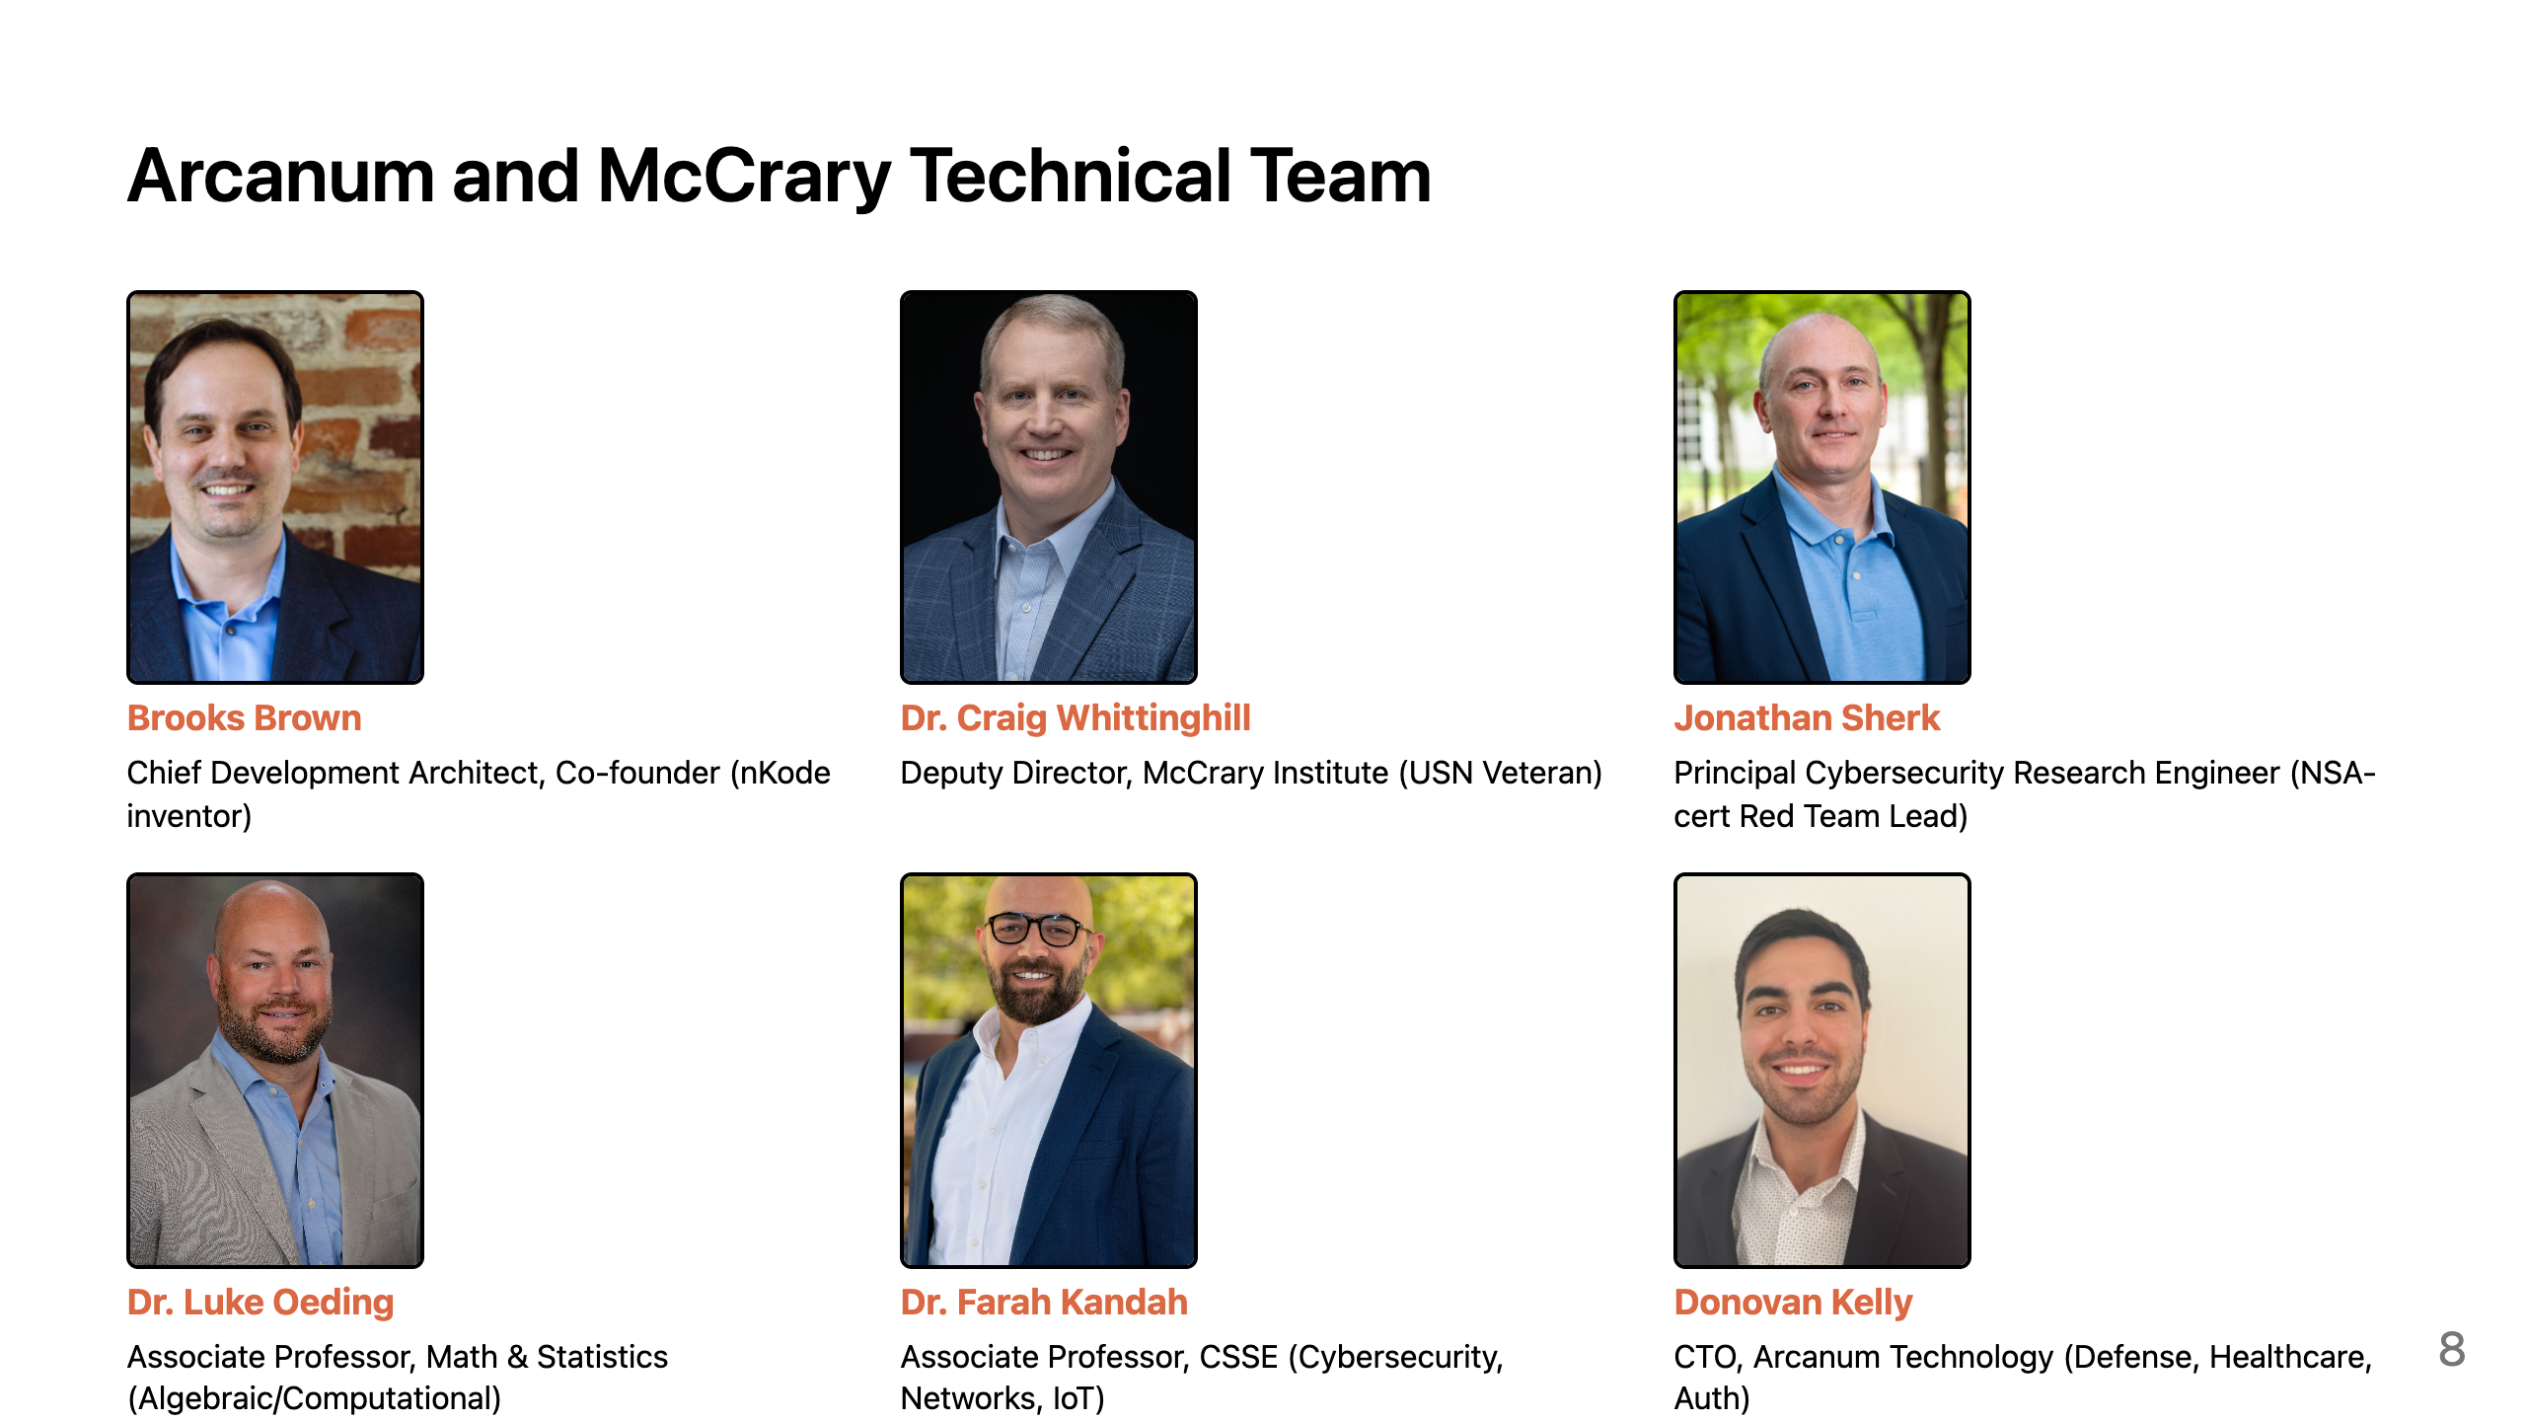
Notes:
Speakers Notes: Arcanum and McCrary Technical Team
The nKode team represents a collaborative effort between Arcanum Technology LLC and Auburn University’s McCrary Institute for Cyber and Critical Infrastructure Security. It comprises cybersecurity experts, university professors, and innovators focused on advanced authentication solutions.

Slide 9
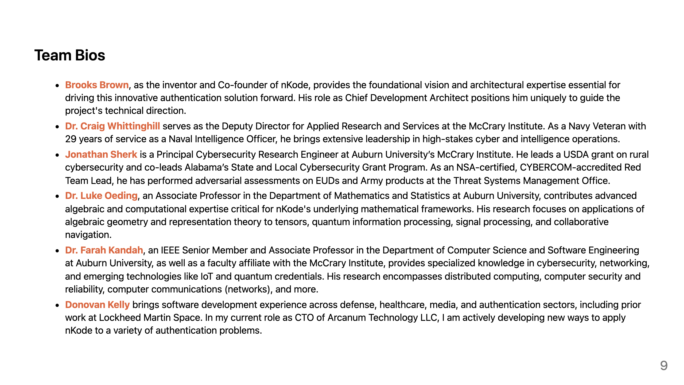
Notes:
Speakers Notes: Team Bios
The key members of the nKode team include Brooks Brown, who serves as the inventor, co-founder, and chief development architect; Dr. Craig Whittinghill, the deputy director and a Navy veteran with deep expertise in cyber and intelligence operations; Jonathan Sherk, a principal cybersecurity research engineer leading grants and red team assessments; Dr. Luke Oeding and Dr. Farah Kandah both associate professors at Auburn Univeristy; and Lastly me. I'm the CTO at Arcanum. I bring software development experience from defense, and healthcare sectors.

Slide 10
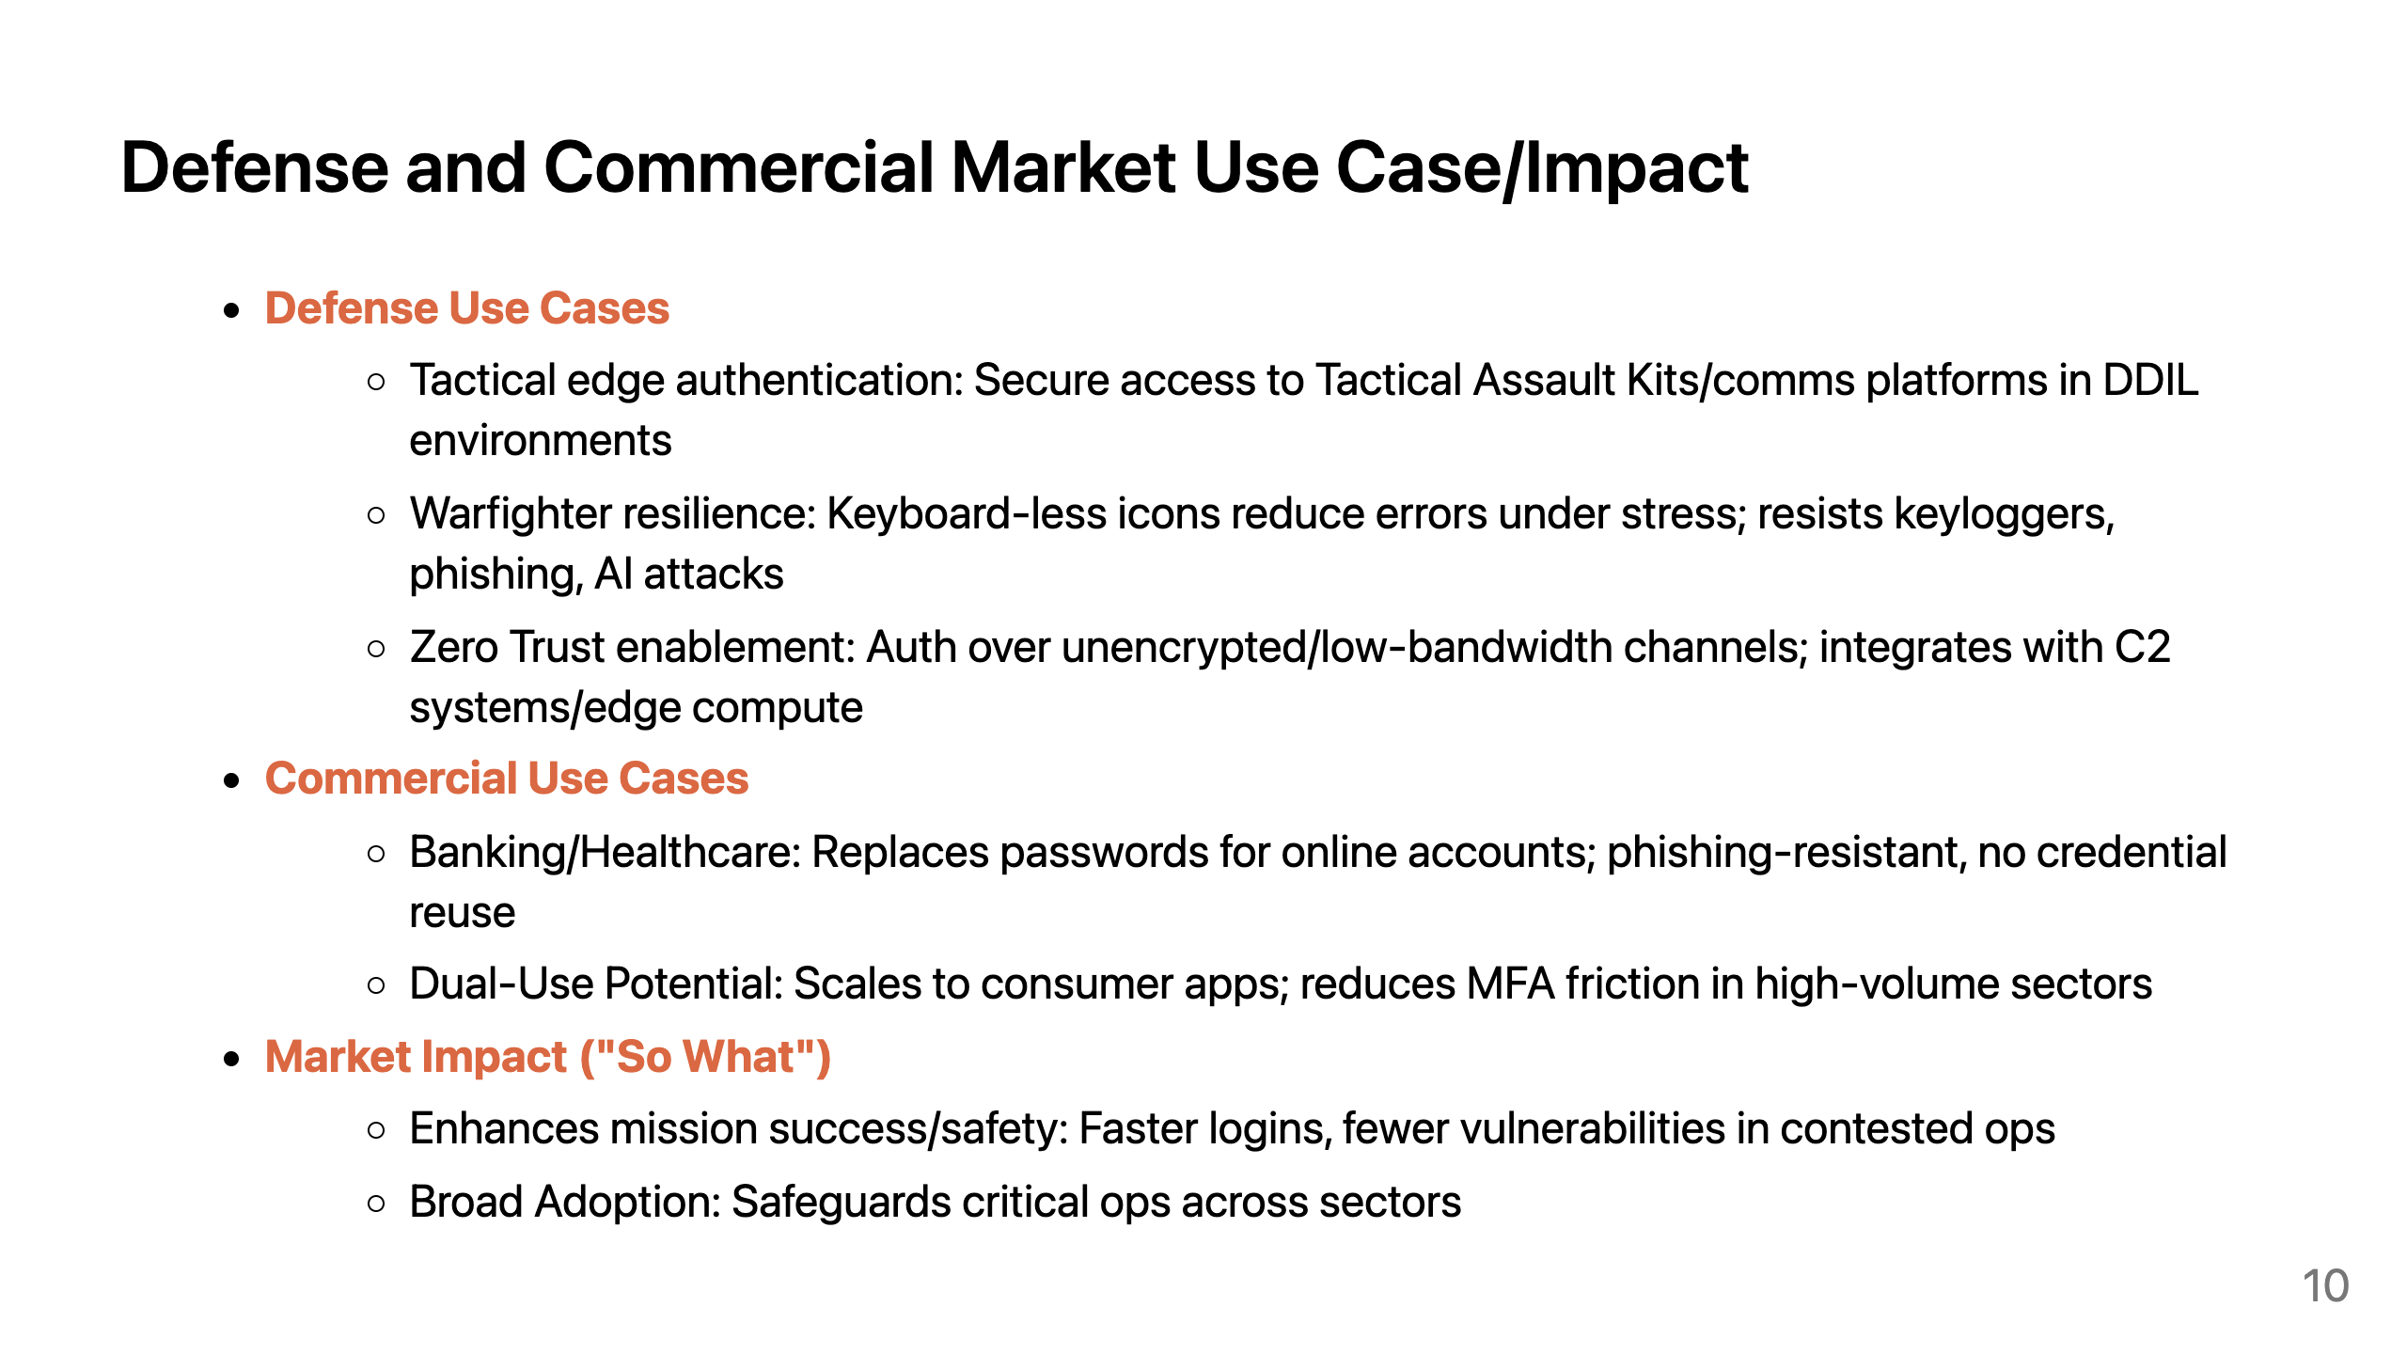
Notes:
Speakers Notes: Defense and Commercial Market Use Case/Impact
nKode offers significant impact in both defense and commercial markets.
In defense, nKode targets tactical edge challenges where current authentication systems falter.
Commercially, nKode addresses massive markets. Replaces vulnerable passwords in banking (reducing phishing losses) or healthcare (securing patient data).
nKode closes usability-security gaps, created by passwords.

Slide 11
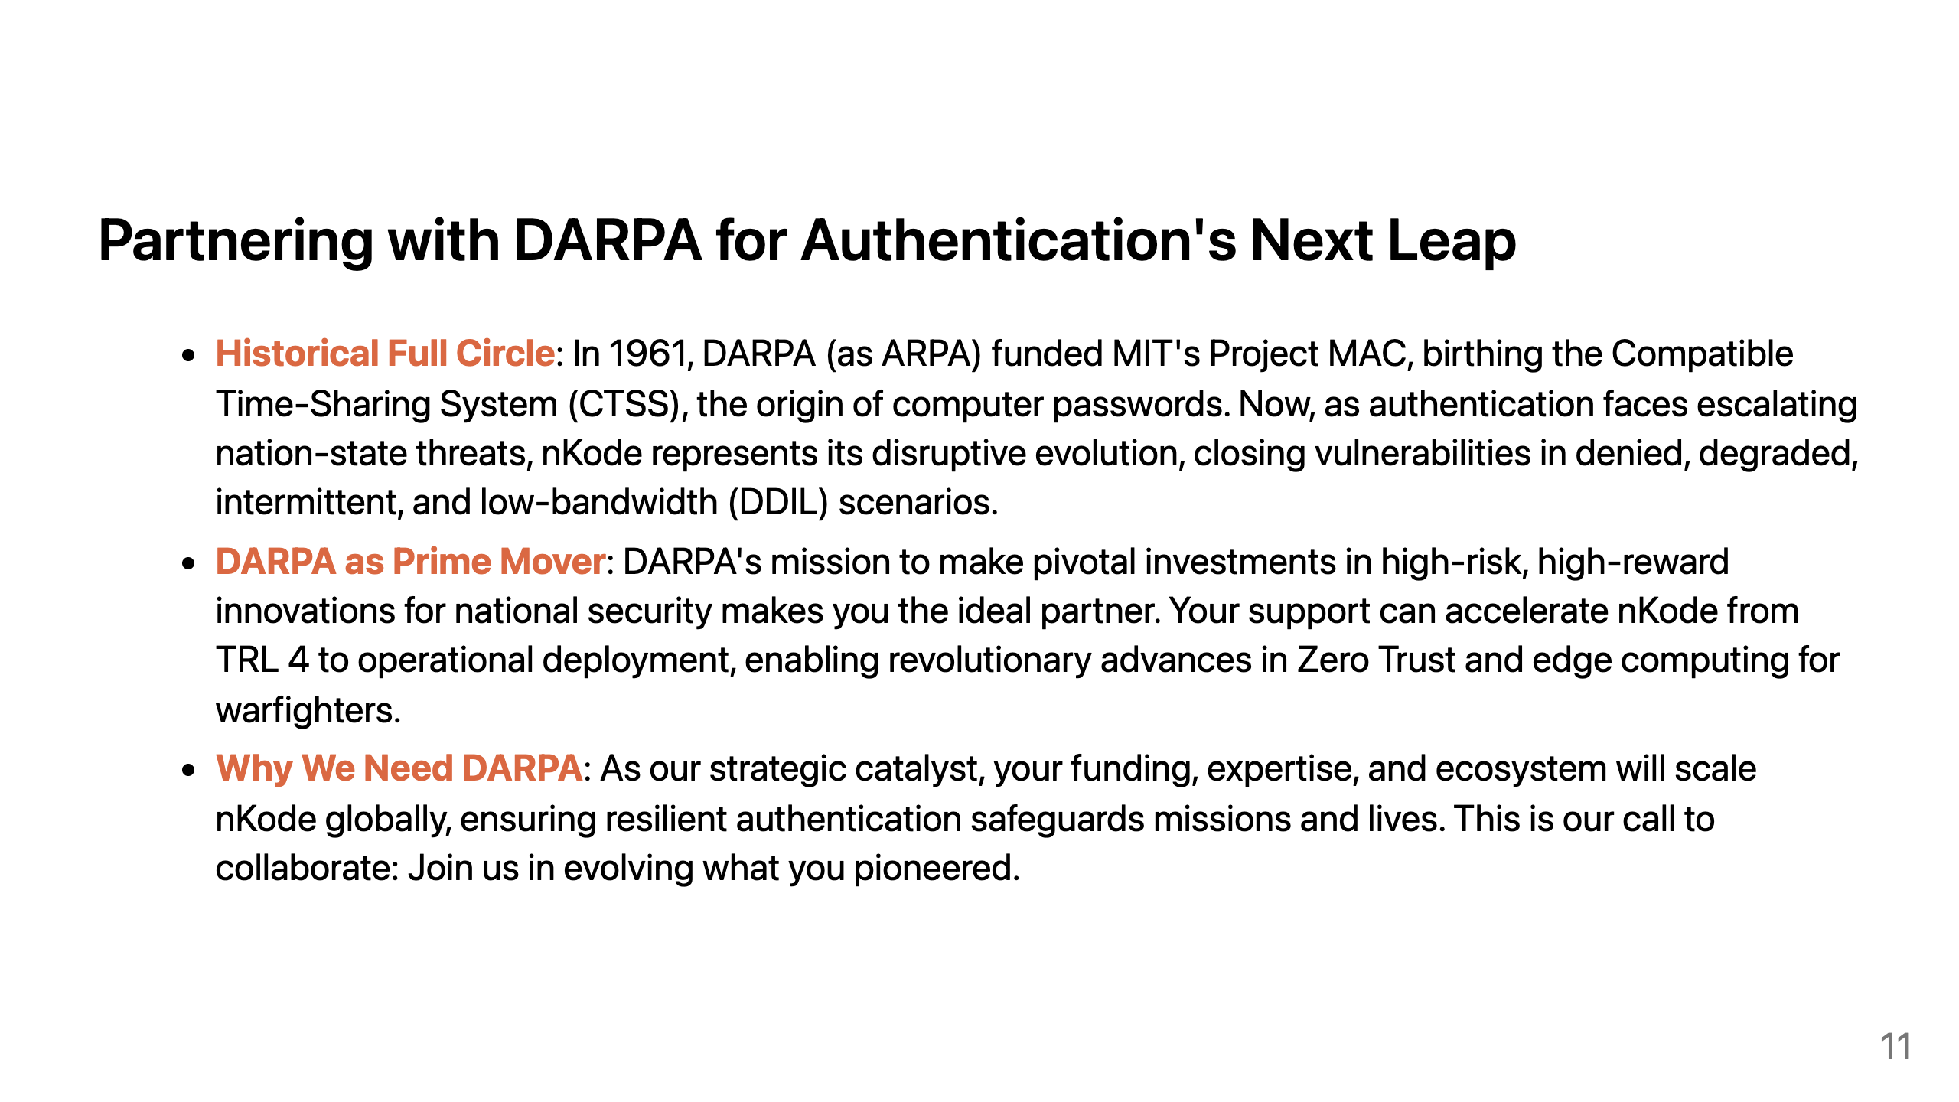
Notes:
Speakers Notes: Partnering with DARPA for Authentication's Next Leap
Back in 1961, ARPA, funded MIT's Project MAC, which led to the Compatible Time-Sharing System, and the very first use of computer passwords.
DARPA is the prime mover in transformative tech. Your mission is to make pivotal investments in high-risk, high-reward innovations for national security.
That's why we need DARPA now, as our strategic catalyst. Your funding, expertise, and vast ecosystem will help us scale nKode, ensuring resilient authentication that safeguards missions, infrastructure, bank accounts, healthcare and more. Together, we can close this 60-year loop.

